Slide 1

EPE – Carpenter trade
Andreas Vuylsteke
Group 4 - 5th semester ATCM - VIA University College

Slide 2
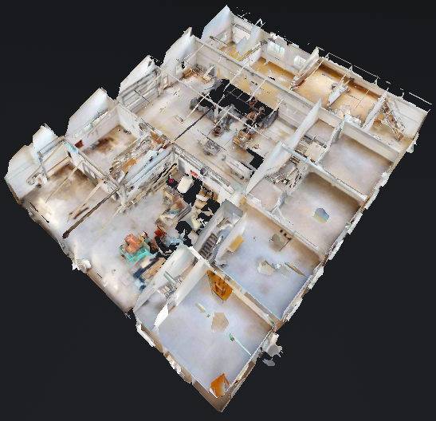
Content
Document list
Time schedule
Plans
Details
Documents regarding law

Slide 3
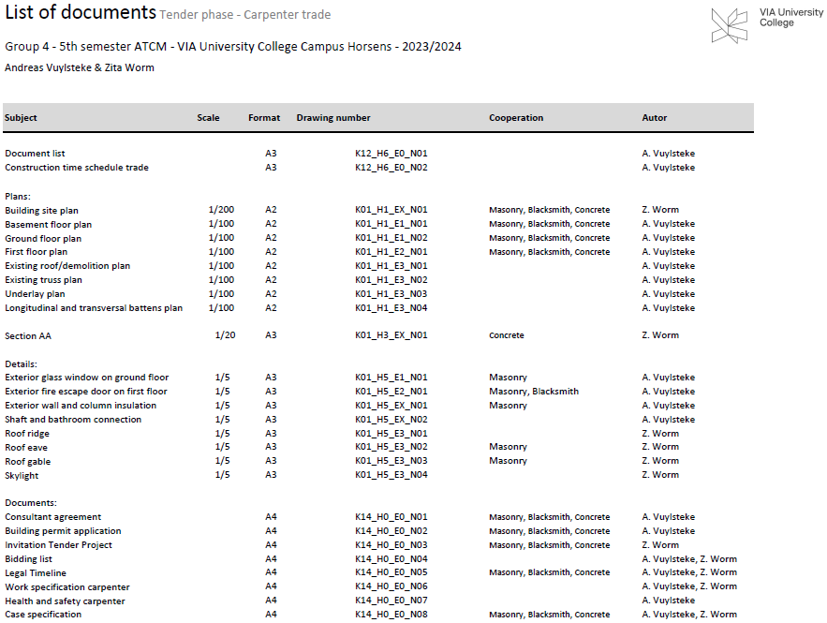
Document list
K12_H6_E0_N01

Slide 4
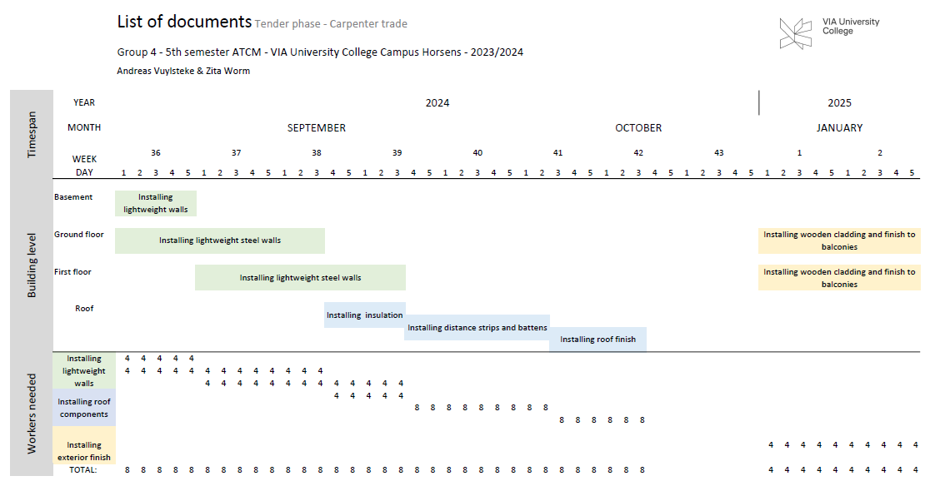
Time schedule carpenter trade
K12_H6_E0_N02

Slide 5
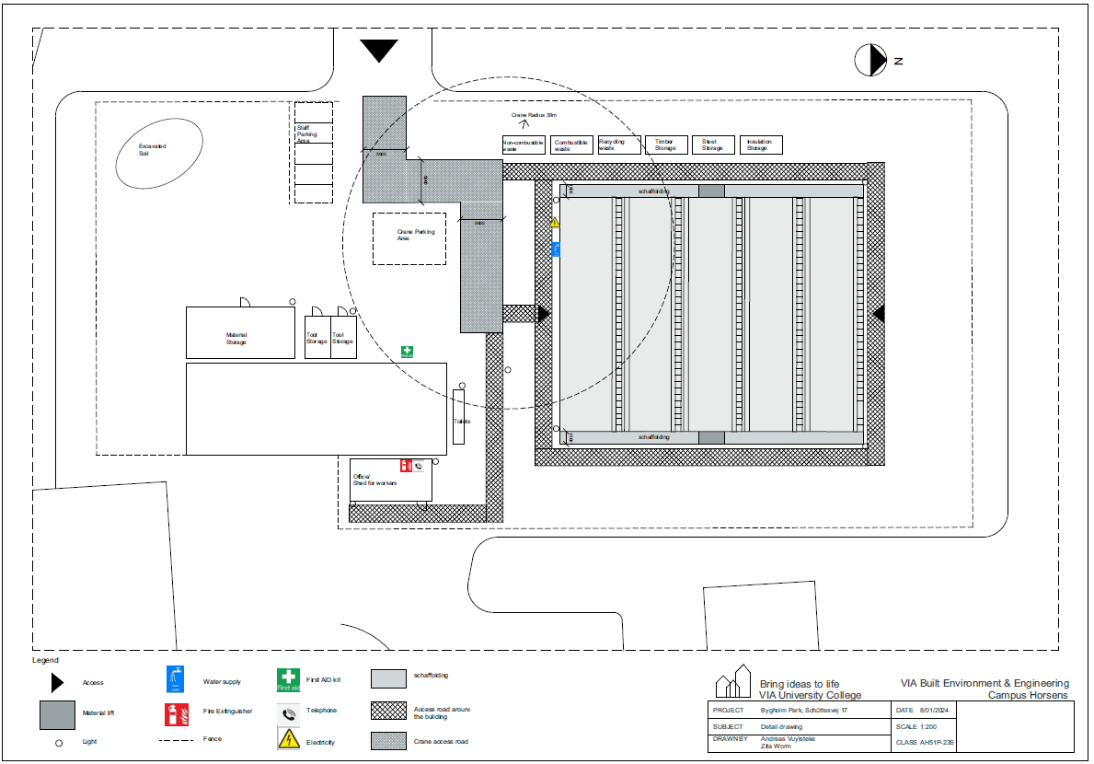
Building site plan
K01_H1_EX_N01

Slide 6
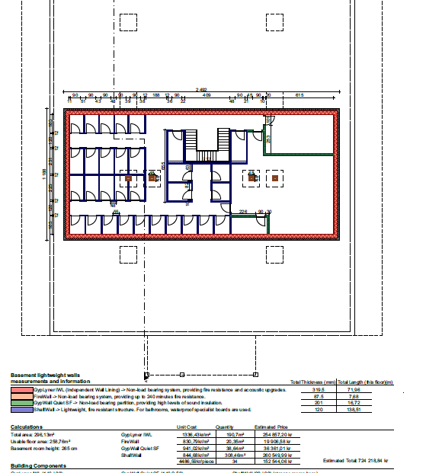
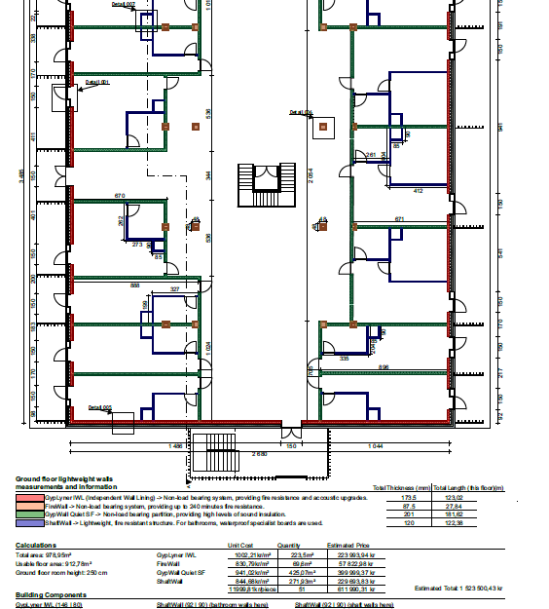
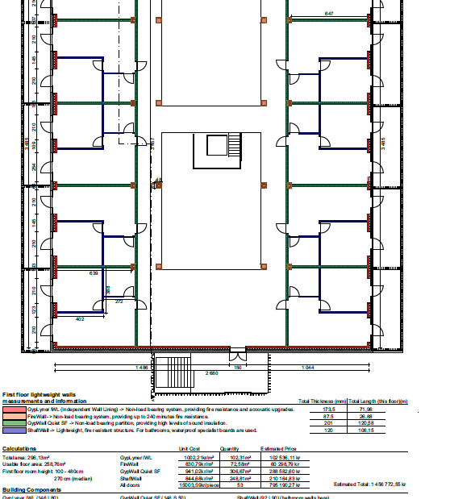
Floor plans
K01_H1_E1_N01 / K01_H1_E1_N02 / K01_H1_E2_N01

Slide 7
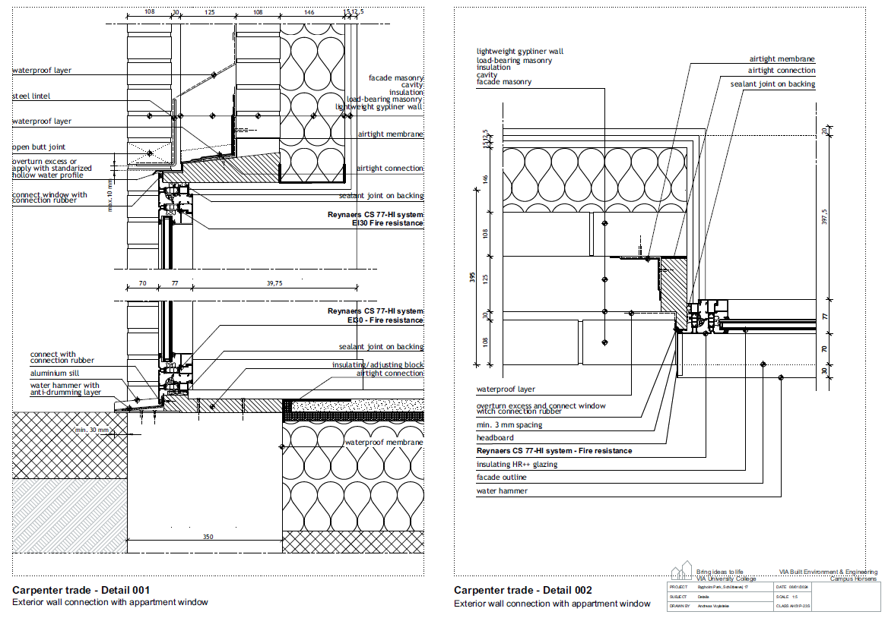
Exterior glass window on ground floor
K01_H5_E1_N01

Slide 8
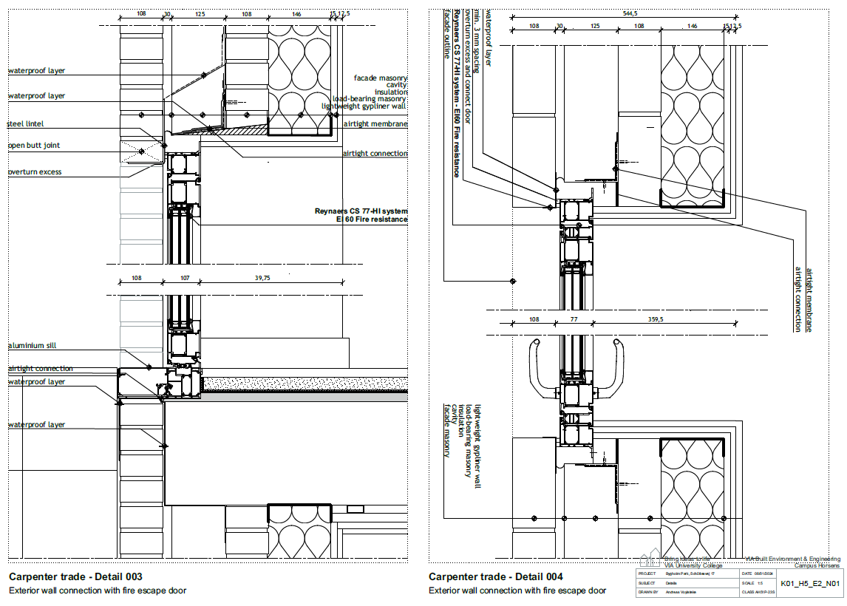
Exterior fire escape door on first floor
K01_H5_E2_N01

Slide 9
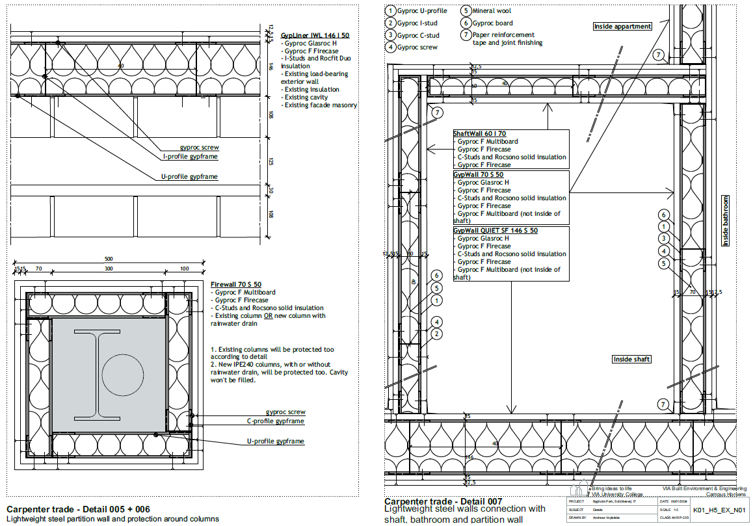
Exterior wall and column insulation – Partition wall, shaft and bathroom connection
K01_H5_EX_N01

Slide 10
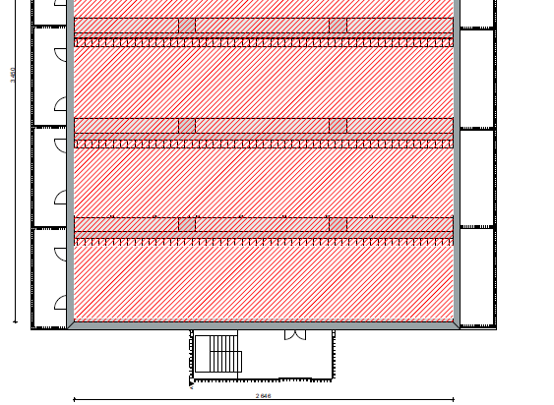
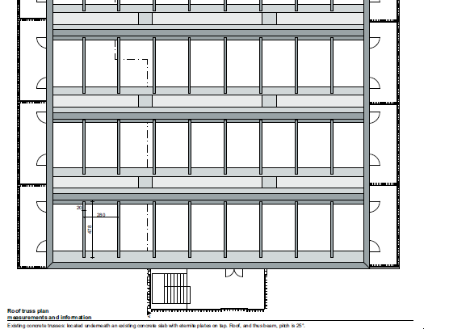
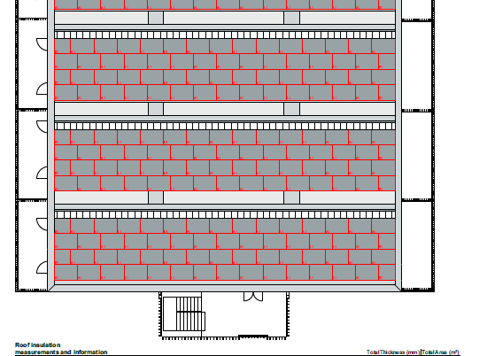
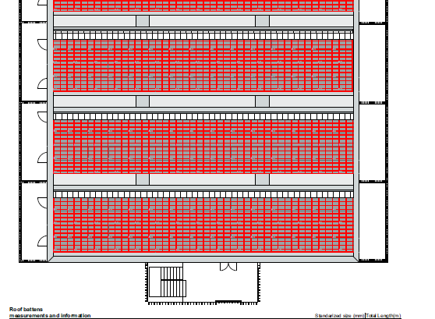
Roof plans
K01_H1_E3_N01 K01_H1_E3_N02 K01_H1_E3_N03
K01_H1_E3_N04

Slide 11
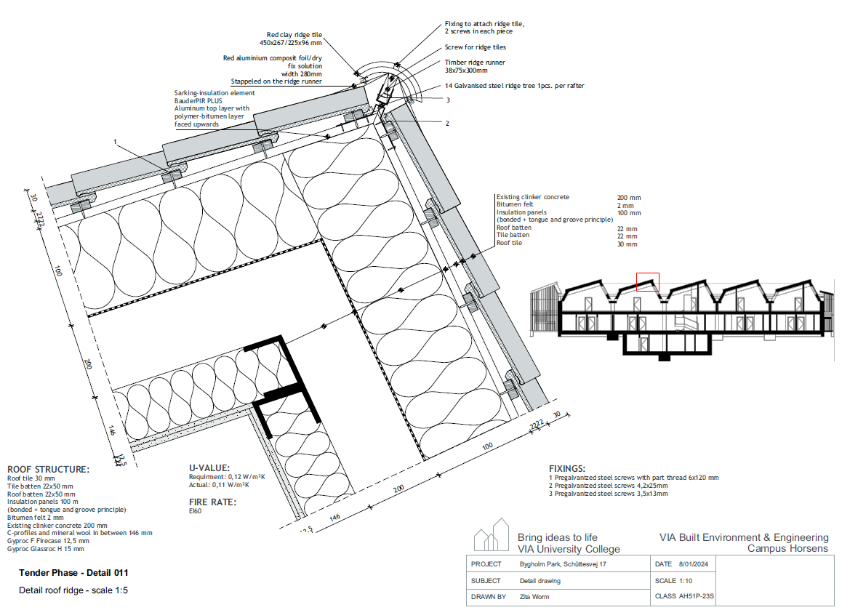
Roof ridge
K01_H5_E3_N01

Slide 12
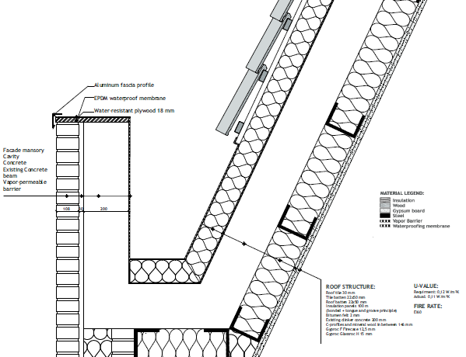
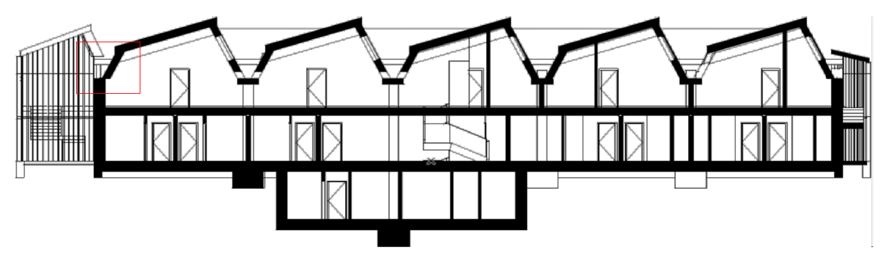
Roof eave
K01_H5_E3_N02

Slide 13
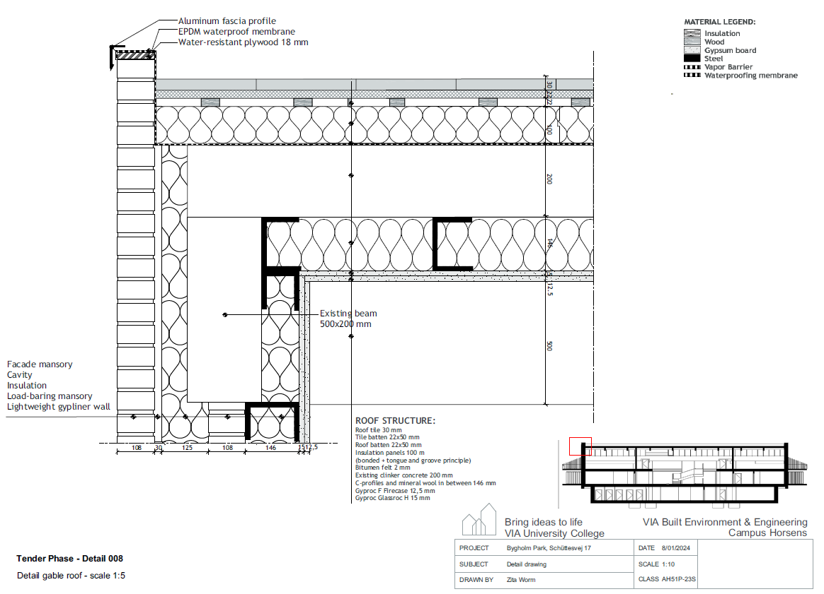
Roof gable
K01_H5_E3_N03

Slide 14
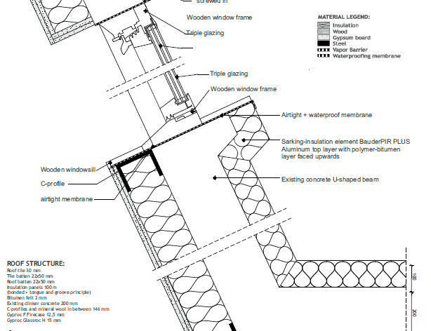
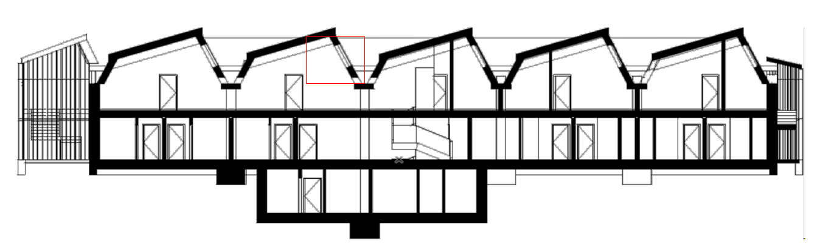
Roof skylight
K01_H5_E3_N04

Slide 15
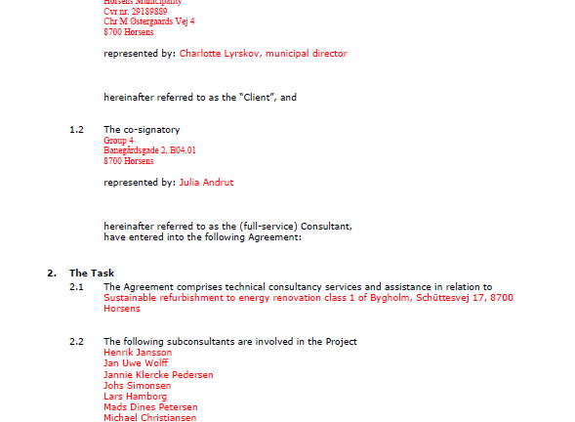
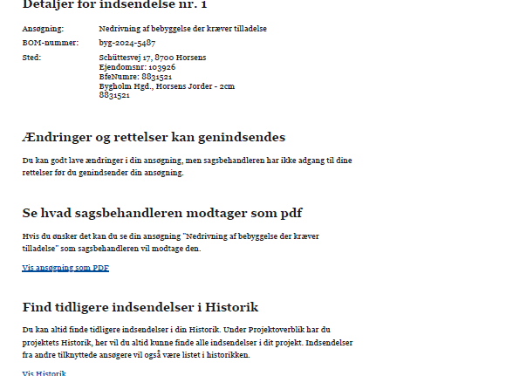
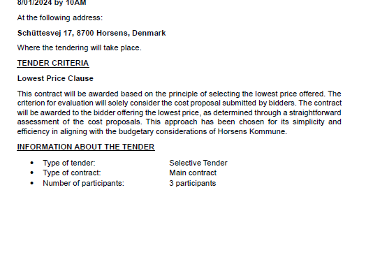
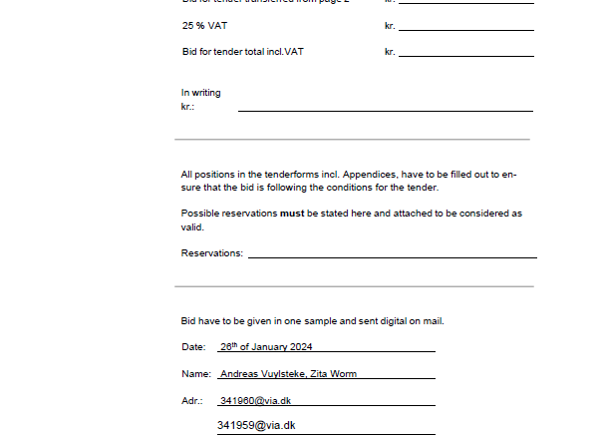
Documents regarding law
- Consultant agreement
- Building permit application
- Invitation tender project
- Bidding list
- Legal timeline
- Work specification
- Health and Safety (PSH)
- Case specification

Slide 16

Thank you
Andreas Vuylsteke
Andreas.vuylsteke@gmail.com
341960@via.dk
www.andreasvuylsteke.be

