Slide 1
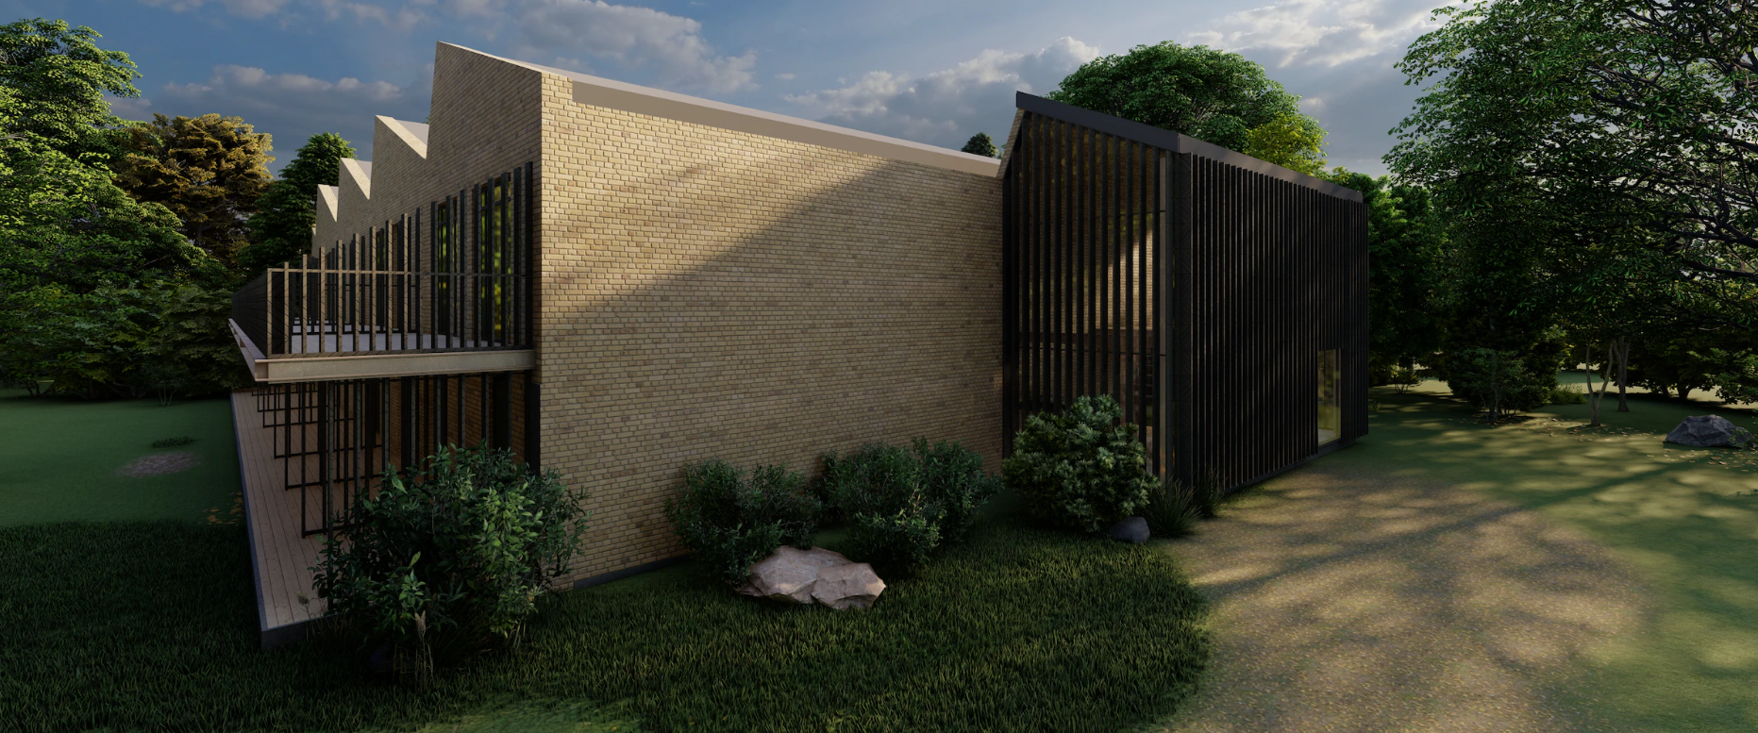
Renovation Project
Architectural Technology and Construction Management
5th Semester -- Renovation Project
GROUP 4--AH51P-23S
8/01/2024

Slide 2
AGENDA
REFLECTION ON THE SEMESTER
INTRODUCTION TO GROUP
PHASES –
  SURVEY AND REGISTRATION
  OUTLINE PROPOSAL
    DESIGN ISSUES FOUND
    DESIGN UPDATES
  PROJECT PROPOSAL
    SOLVING TECHNICAL ASPECTS
  REGULATORY PROJECT
    UPGRADING ACCORDING TO THE BR
    APPLYING FOR A BUILDING PERMIT
LPE – Local Element Programme
GROUP
REGISTRATION PHASE
OUTLINE PROPOSAL
PROJECT PROPOSAL
REGULATORY PROJECT
DOCUMENT
LIST

Slide 3
SEMESTER
REFLECTION ON THE SEMESTER
GROUP
REGISTRATION PHASE
OUTLINE PROPOSAL
PROJECT PROPOSAL
REGULATORY PROJECT
DOCUMENT
LIST

Slide 4
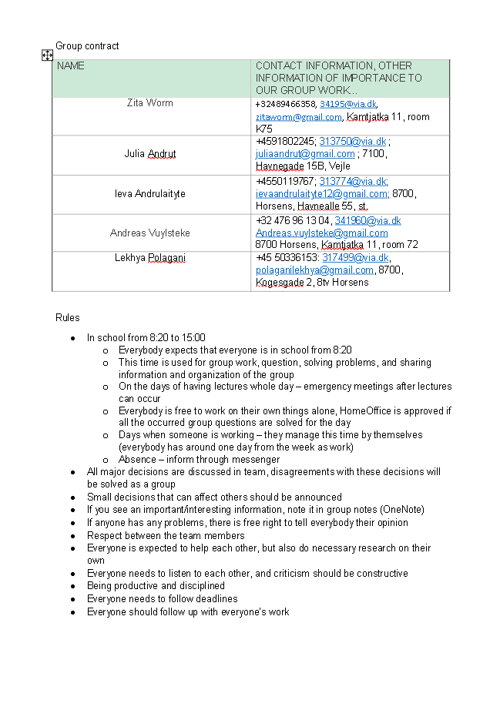
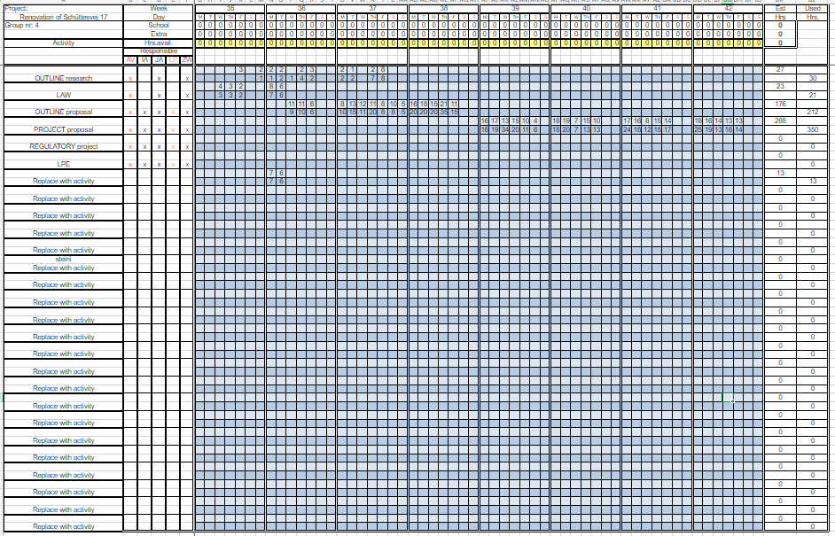
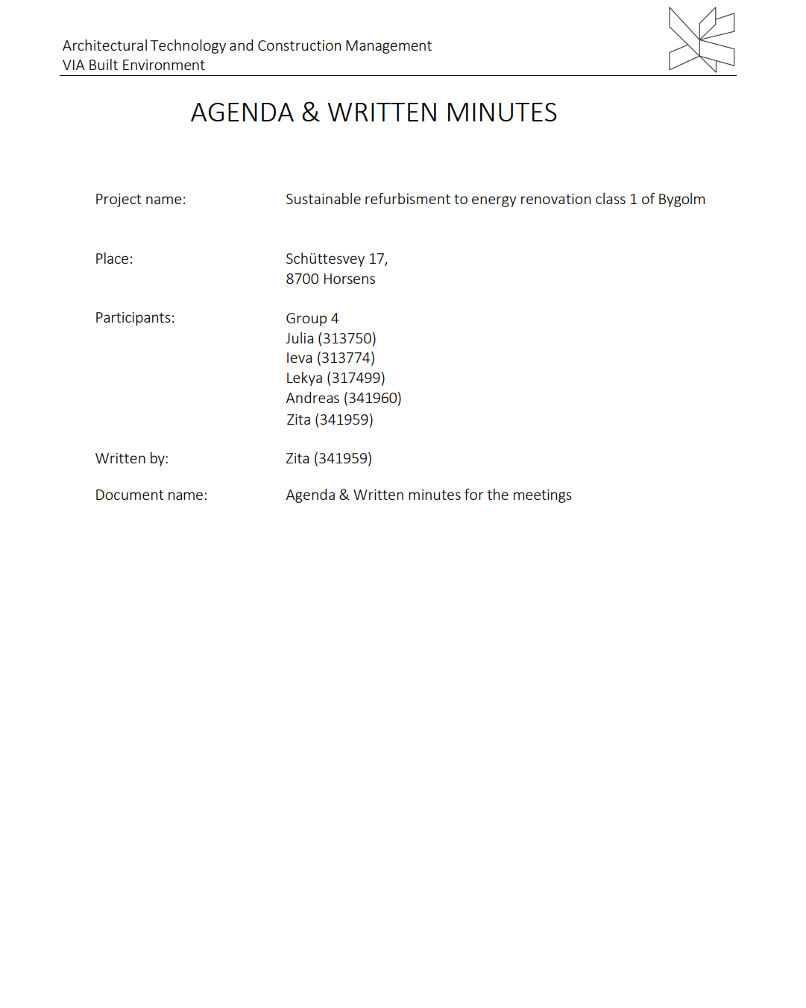
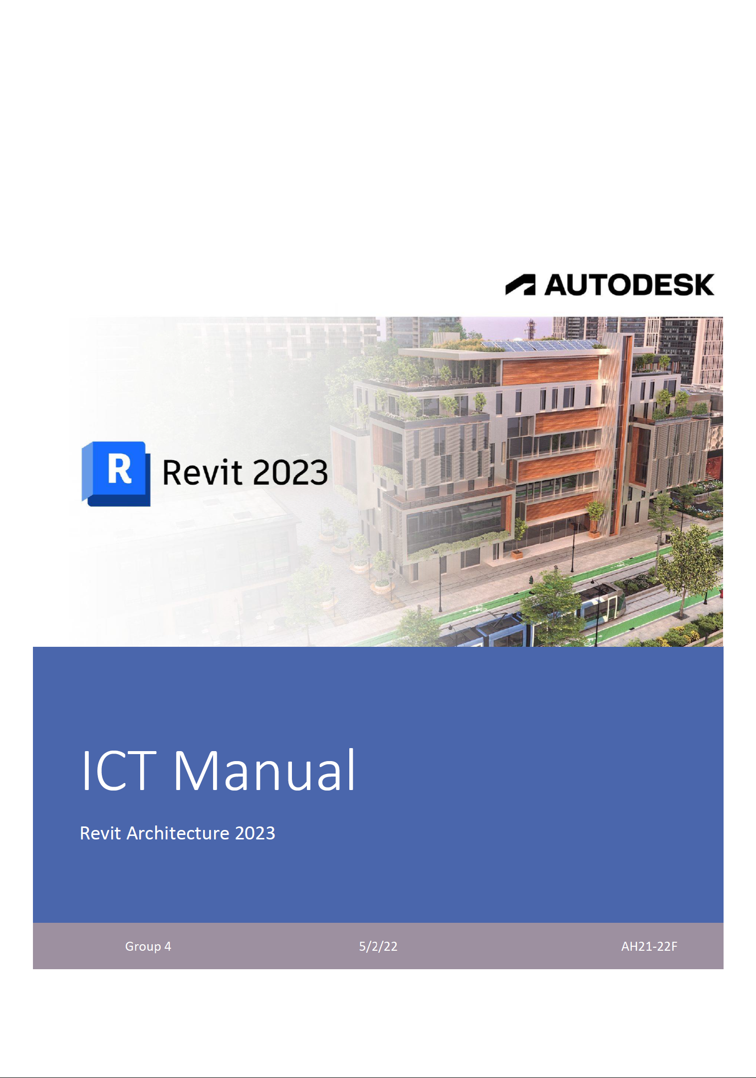
WORK
IEVA
ANDREAS
JULIA
LEKHYA
ZITA
GROUP
REGISTRATION PHASE
CONTRACT
TIME MANAGEMENT
MEETINGS
ICT MANUAL
OUTLINE PROPOSAL
PROJECT PROPOSAL
REGULATORY PROJECT
DOCUMENT
LIST

Slide 5
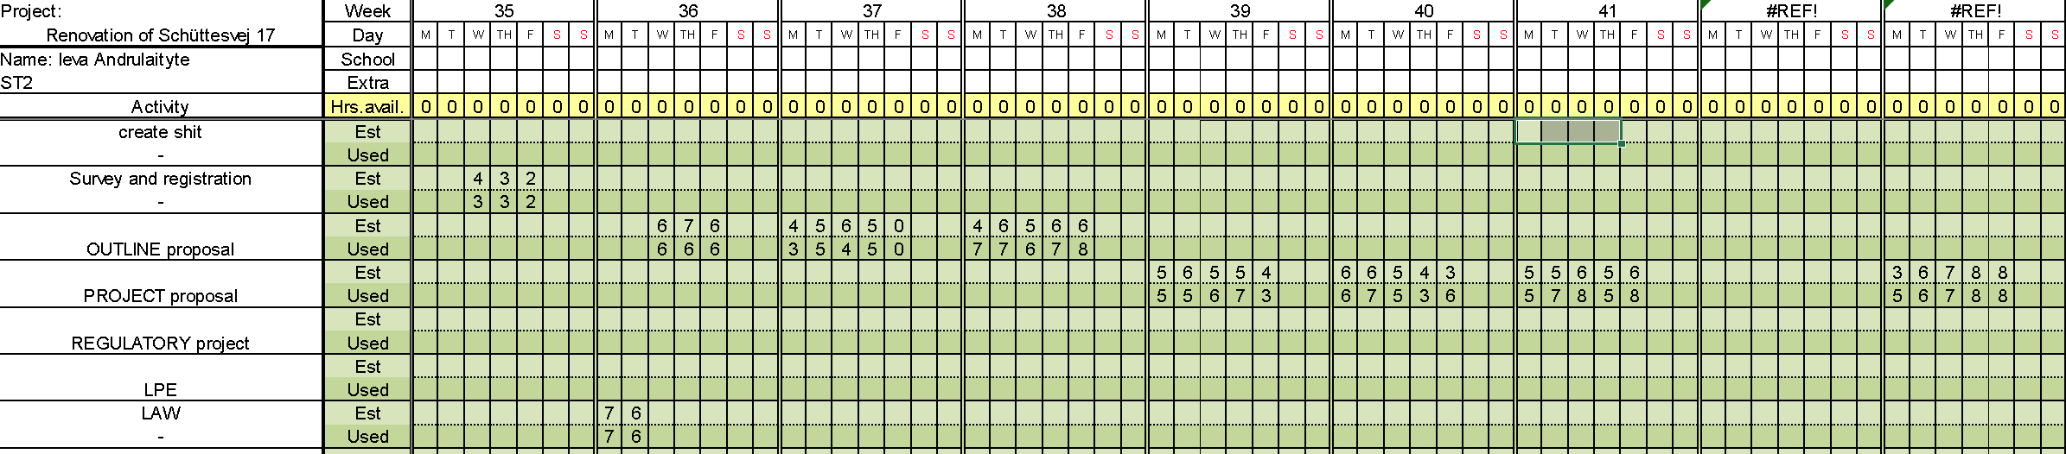
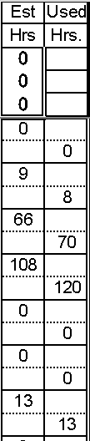



WORK
IEVA
ANDREAS
JULIA
LEKHYA
ZITA
GROUP
REGISTRATION PHASE
TIME MANAGEMENT​
IEVA ANDRULAITYTE
43
42
OUTLINE PROPOSAL
PROJECT PROPOSAL
REGULATORY PROJECT
PORTFOLIO​
DOCUMENT
LIST

Slide 6
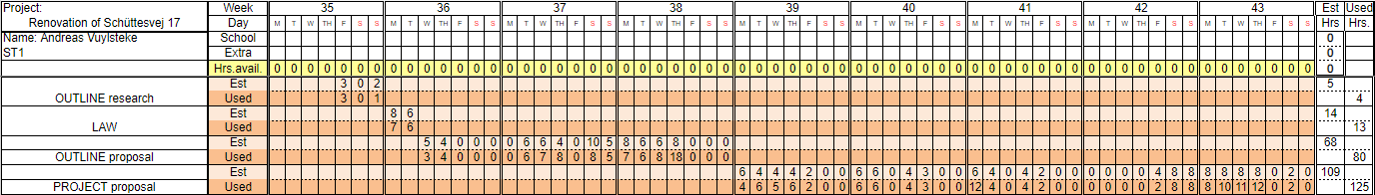
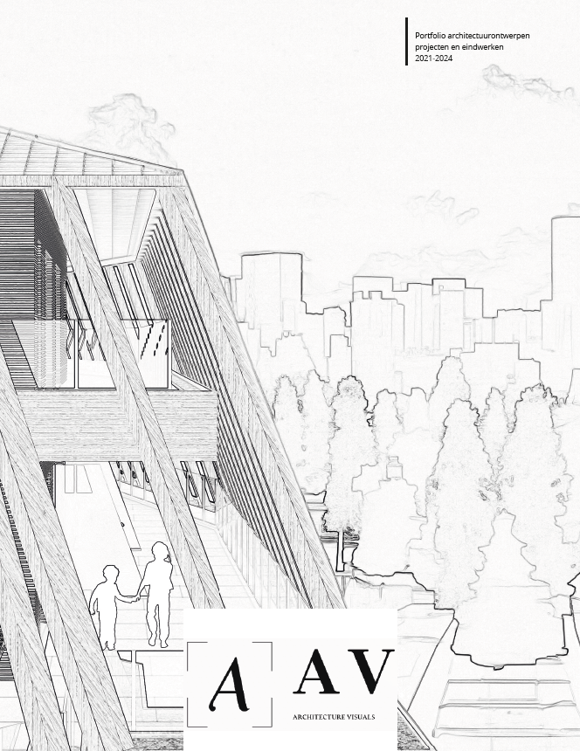


WORK
IEVA
ANDREAS
JULIA
LEKHYA
ZITA
GROUP
TIME MANAGEMENT​
REGISTRATION PHASE
OUTLINE PROPOSAL
PROJECT PROPOSAL
PORTFOLIO​
ANDREAS VUYLSTEKE
REGULATORY PROJECT
DOCUMENT
LIST

Slide 7
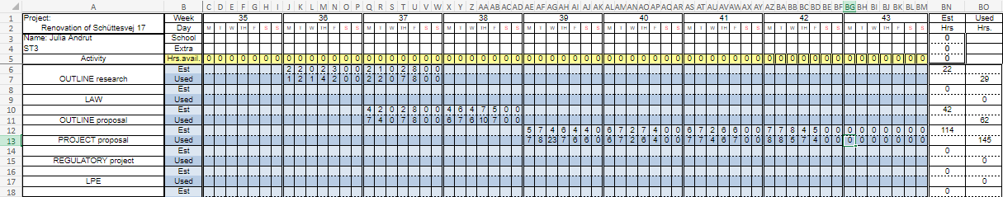

WORK
IEVA
ANDREAS
JULIA
LEKHYA
ZITA
GROUP
TIME MANAGEMENT - DESIGN PHASE
REGISTRATION PHASE
OUTLINE PROPOSAL
PROJECT PROPOSAL
REGULATORY PROJECT
PORTFOLIO
DOCUMENT
LIST

Slide 8

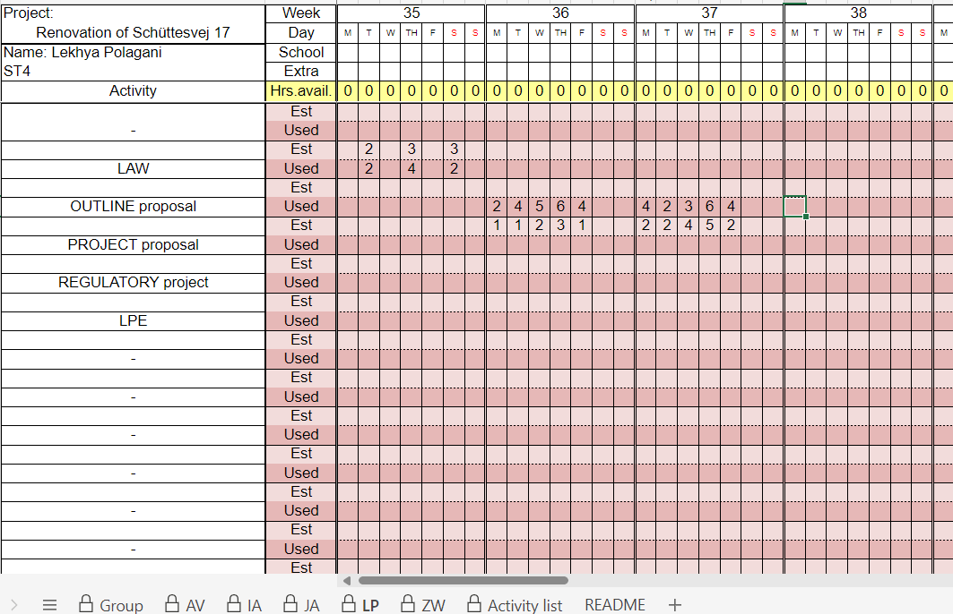
WORK
IEVA
ANDREAS
JULIA
LEKHYA
ZITA
GROUP
REGISTRATION PHASE
TIME MANAGEMENT​
OUTLINE PROPOSAL
PROJECT PROPOSAL
REGULATORY PROJECT
PORTFOLIO​
DOCUMENT
LIST

Slide 9
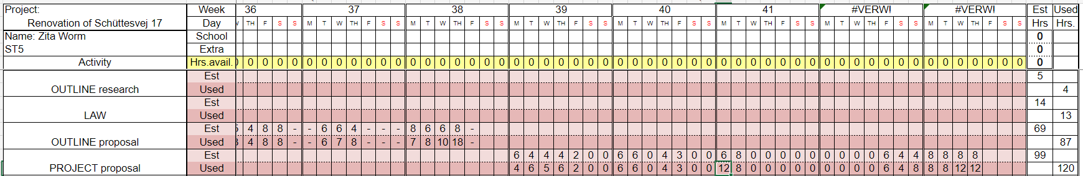


WORK
IEVA
ANDREAS
JULIA
LEKHYA
ZITA
GROUP
REGISTRATION PHASE
TIME MANAGEMENT
OUTLINE PROPOSAL
PROJECT PROPOSAL
PORTFOLIO
ZITA WORM
REGULATORY PROJECT
DOCUMENT
LIST

Slide 10
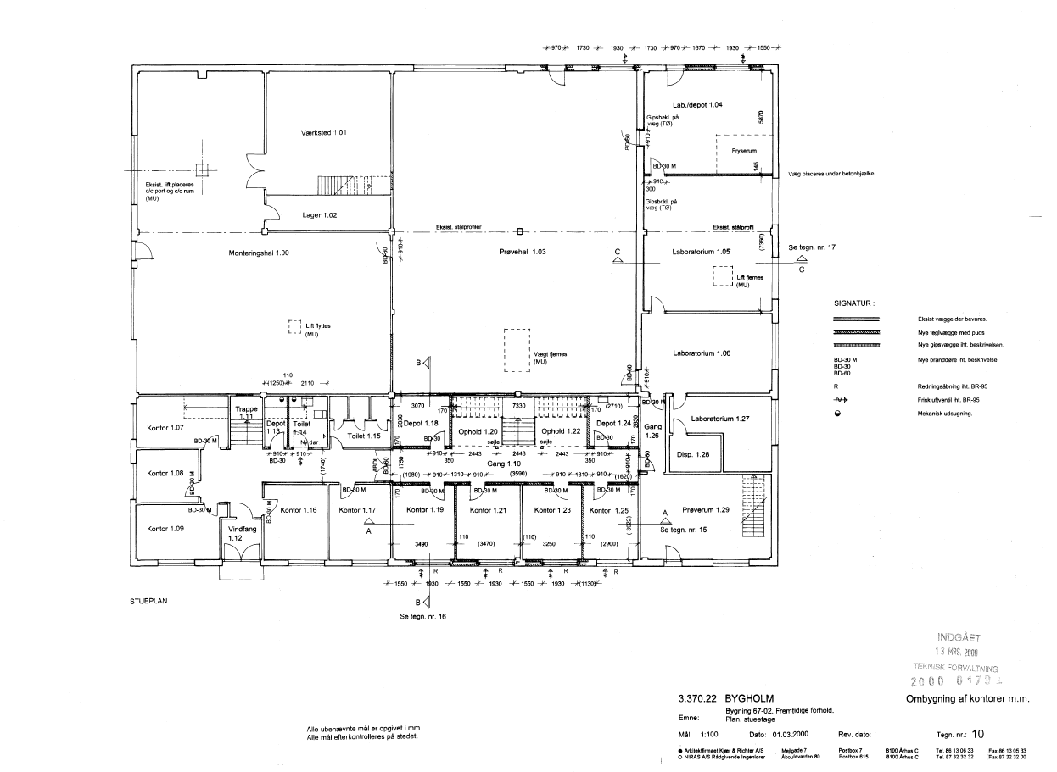
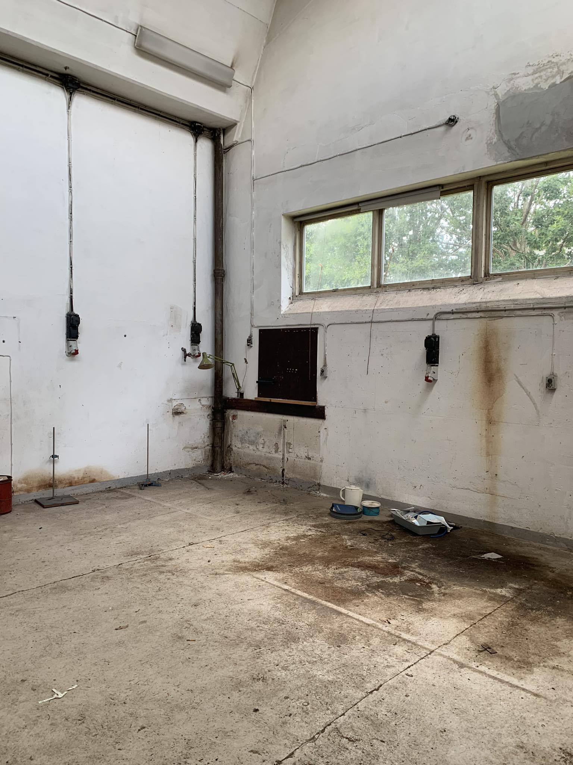
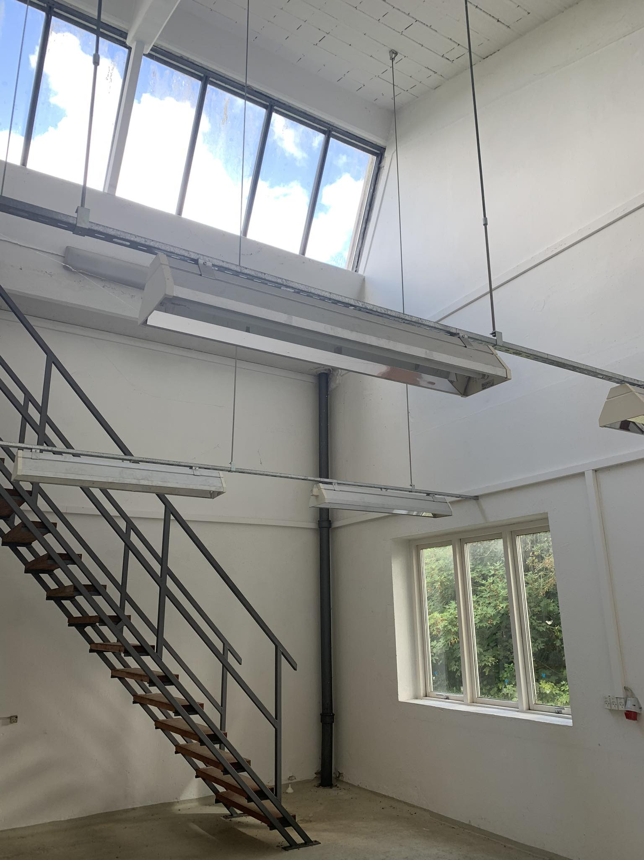
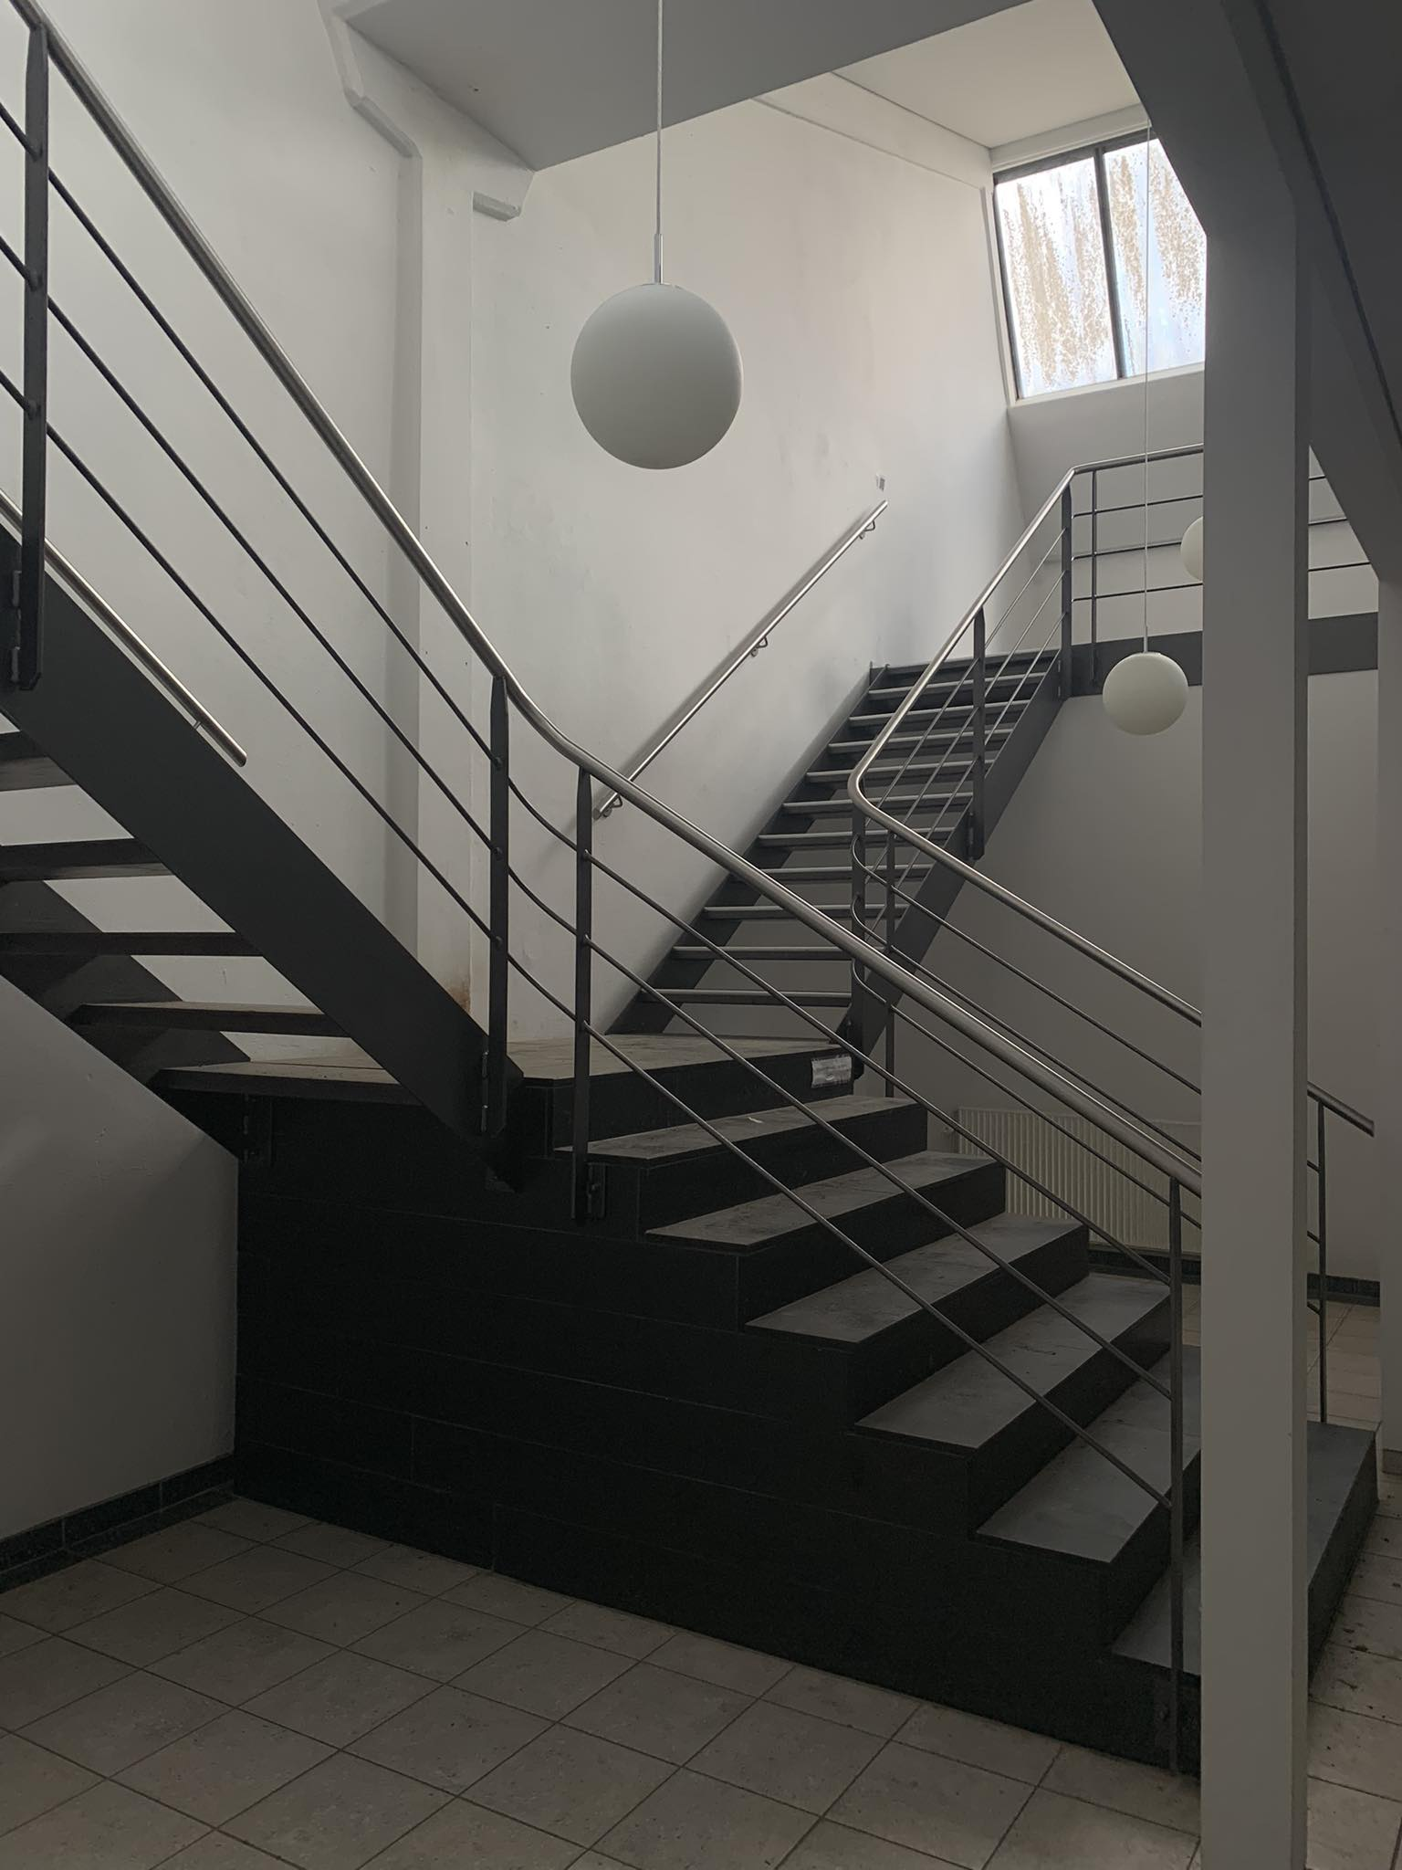
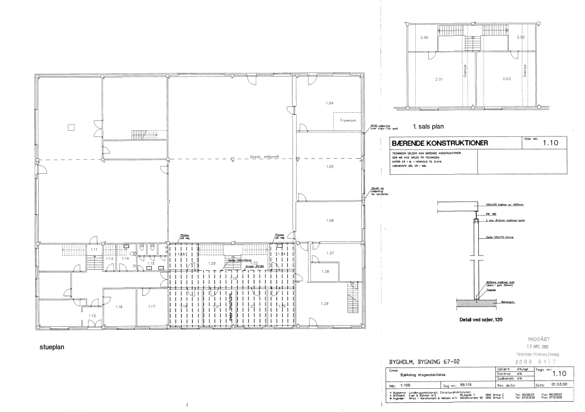
EXISTING
CONDITIONS​
CASE
ANALYSIS
GROUP
REGISTRATION PHASE
OUTLINE PROPOSAL
PROJECT PROPOSAL
REGULATORY PROJECT
DOCUMENT
LIST
GROUP IEVA JULIA LEKHYA ZITA ANDREAS

Slide 11
EXISTING
CONDITIONS​
CASE
ANALYSIS
Schüttesvej 17, 8700 Horsens
Former school building built in 1958 for agricultural technologies.
Consists of:
Multiple offices
Laboratories
Industrial workspaces
For Outline A sustainable refurbishment proposal for Bygholm, Schüttesvej 17, block 14, Horsens.
A suggestion for the layout of a youth residence at the address Bygholm, Schüttesvej 17, block 14, Horsens.
A master plan for the area including all activities, infrastructure, and landscaping.
15 square meters to 40 square meters gross area.
The building will be designed with 25 youth residences, including common areas and outdoor spaces.
10 residences will be single-room units.
10 residences will be two-bedroom units.
5 residences will be adapted for residents with physical challenges.
GROUP
REGISTRATION PHASE
OUTLINE PROPOSAL
PROJECT PROPOSAL
REGULATORY PROJECT
DOCUMENT
LIST
GROUP IEVA JULIA LEKHYA ZITA ANDREAS

Slide 12

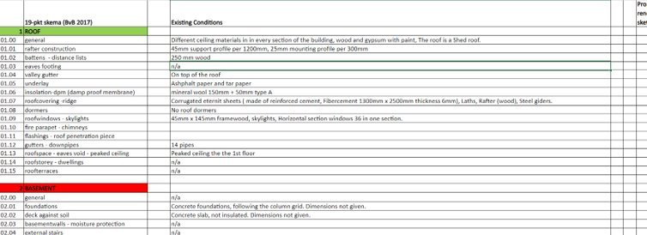
EXISTING
CONDITIONS​
CASE
ANALYSIS
GROUP
REGISTRATION PHASE
OUTLINE PROPOSAL
PROJECT PROPOSAL
REGULATORY PROJECT
DOCUMENT
LIST
GROUP IEVA JULIA LEKHYA ZITA ANDREAS

Slide 13
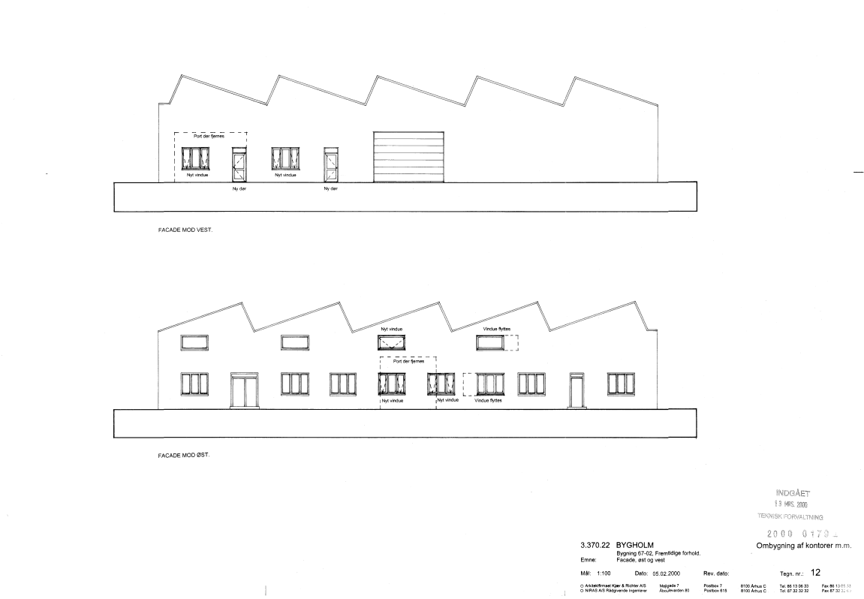
PHASE
IDEAS
PLANS
ANALYSIS & CALCULATIONS
GROUP
REGISTRATION PHASE
HORSENS MUNICIPALITY
OUTLINE PROPOSAL
(DESIGN OFFICE)
PROJECT PROPOSAL
OUTLINE APPROVED:
REGULATORY PROJECT
DOCUMENT
LIST
GROUP IEVA JULIA LEKHYA ZITA ANDREAS

Slide 14
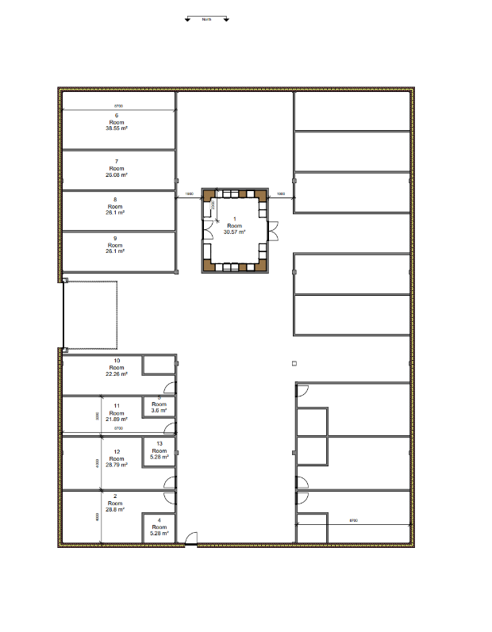
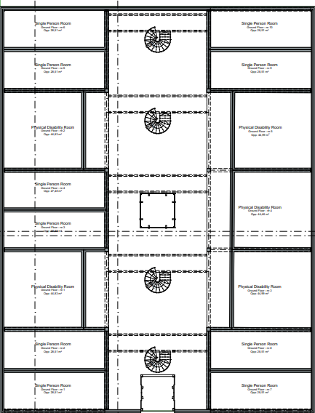
PHASE
IDEAS
PLANS
ANALYSIS & CALCULATIONS
GROUP
REGISTRATION PHASE
OUTLINE PROPOSAL
PROJECT PROPOSAL
REGULATORY PROJECT
DOCUMENT
LIST
GROUP IEVA JULIA LEKHYA ZITA ANDREAS

Slide 15
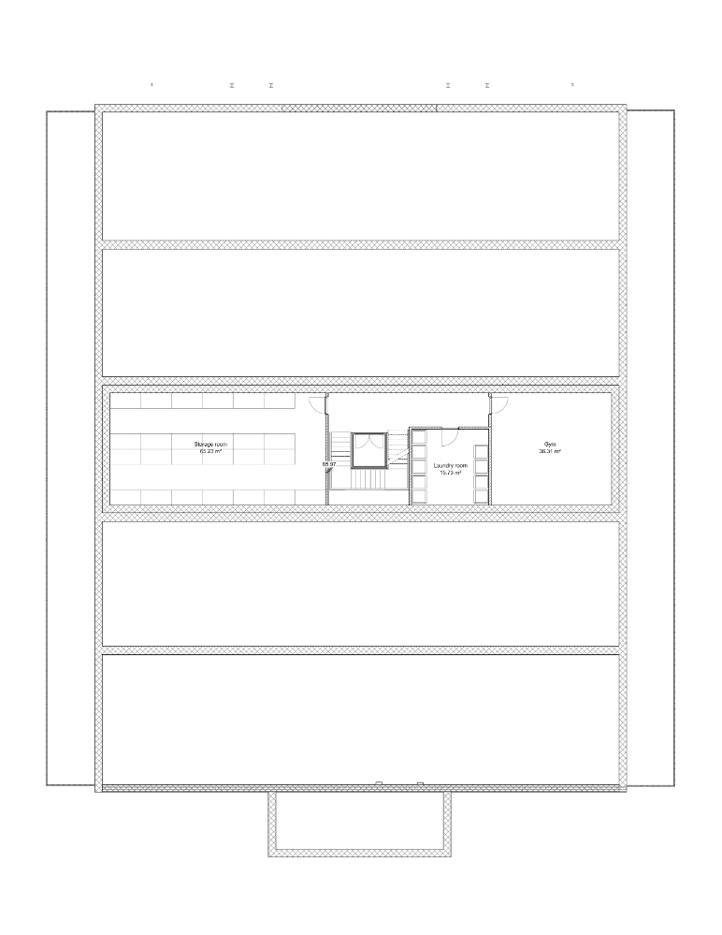
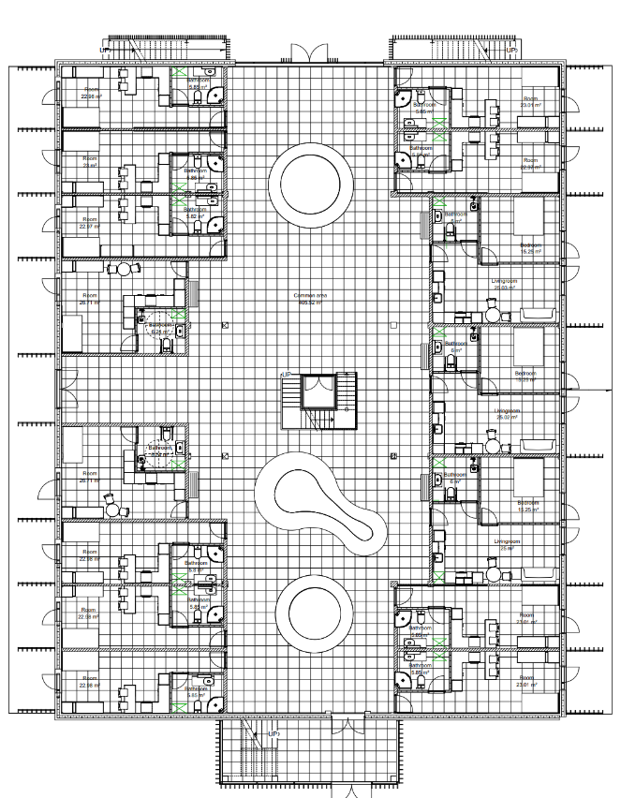
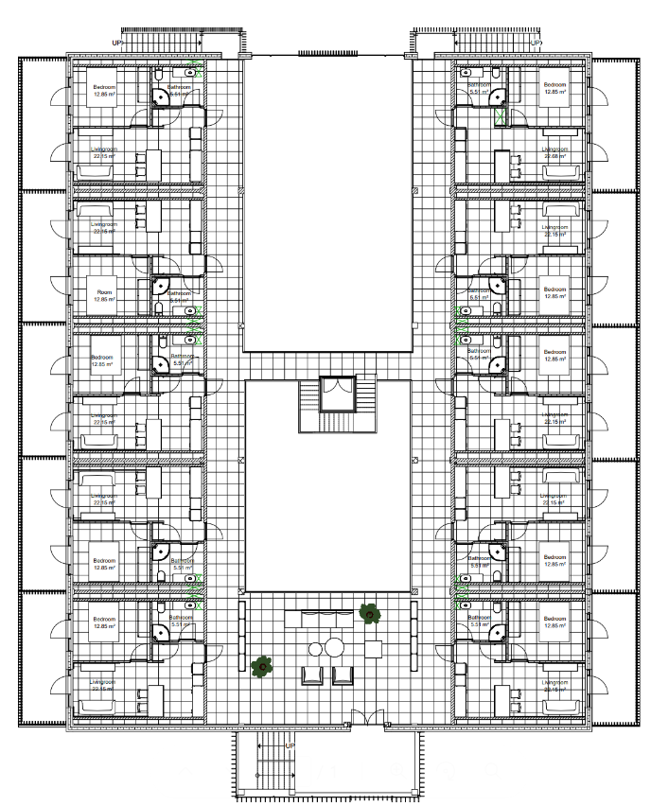
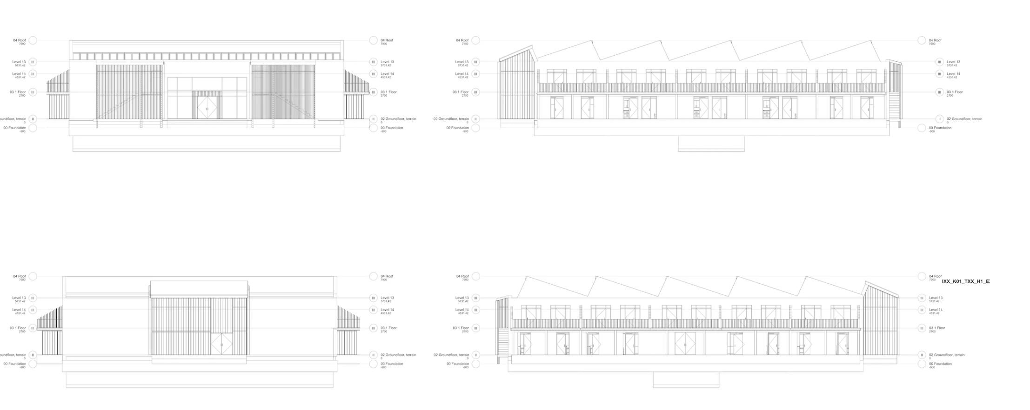
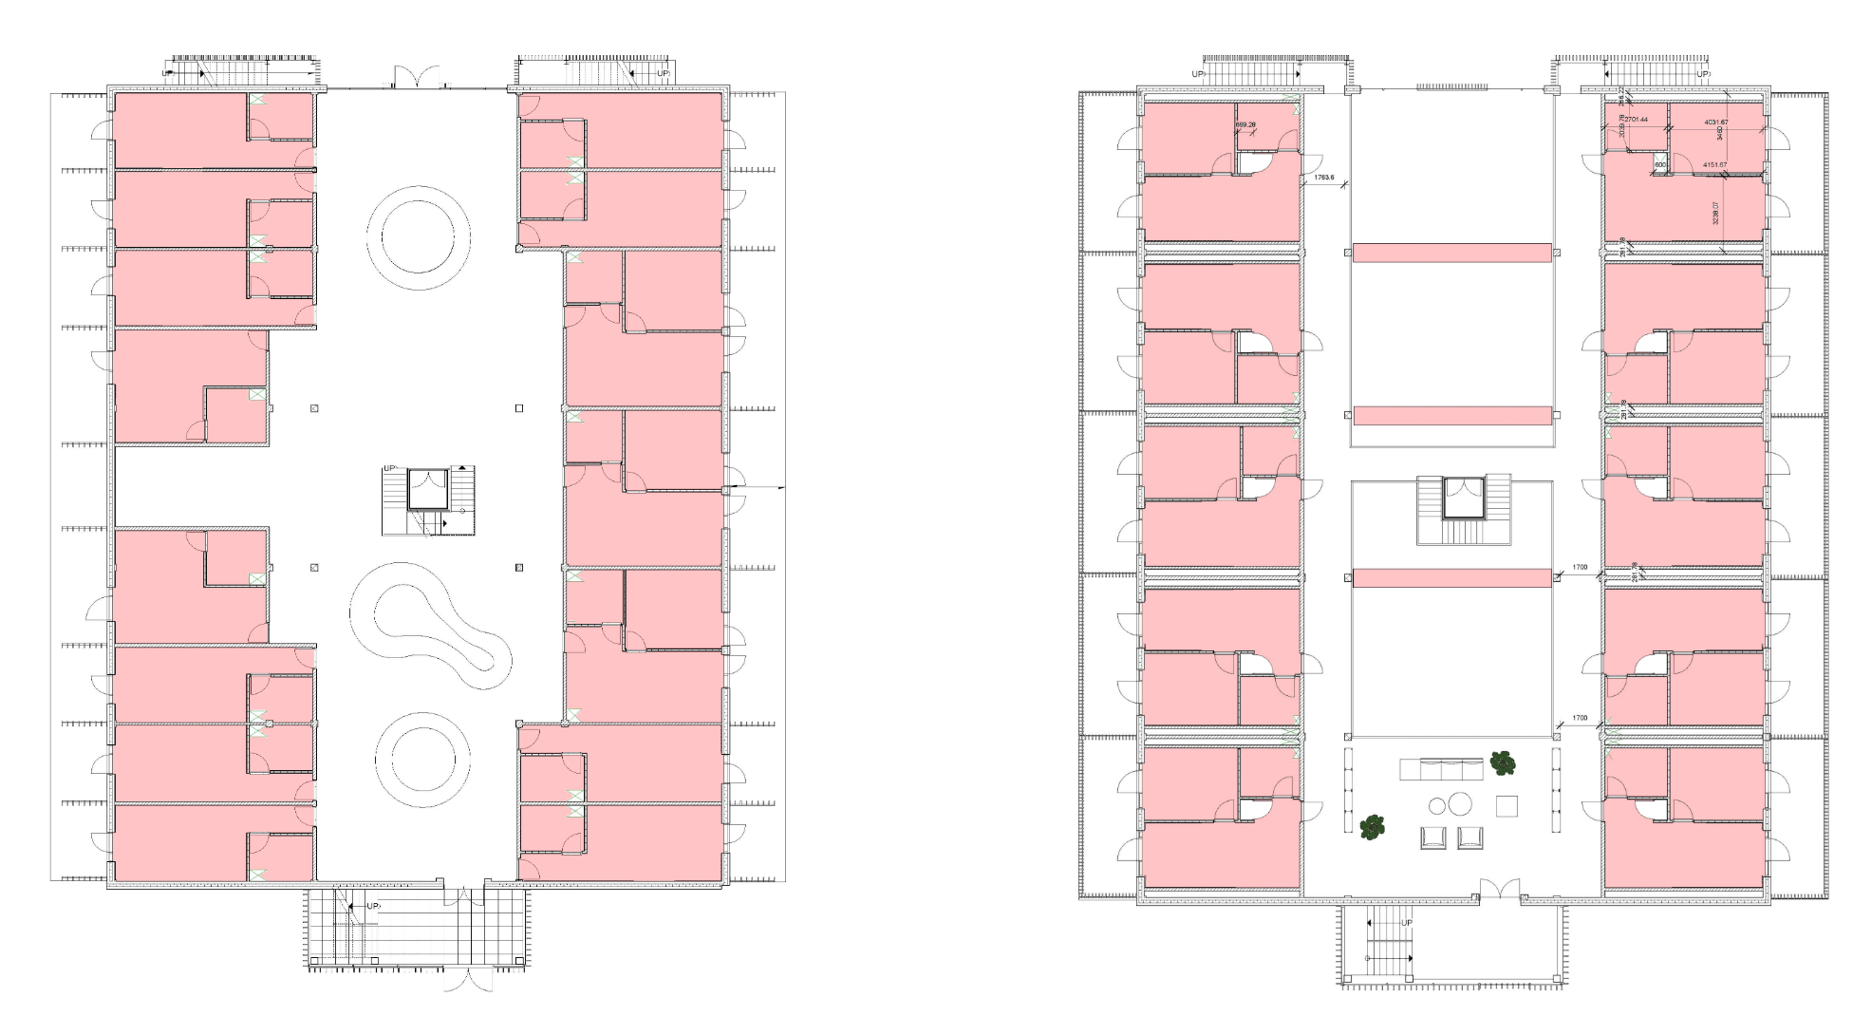
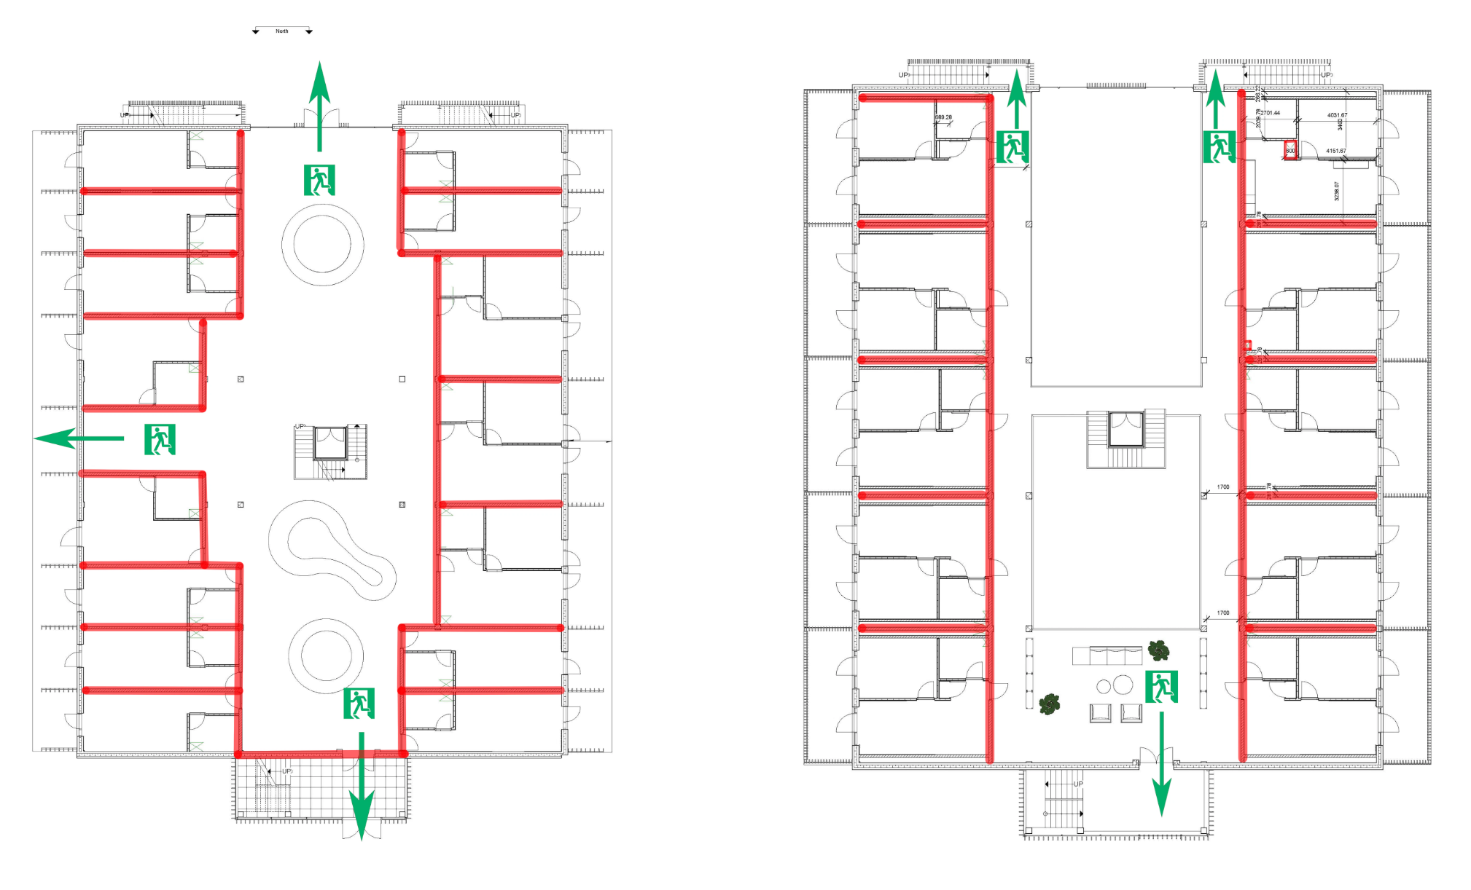
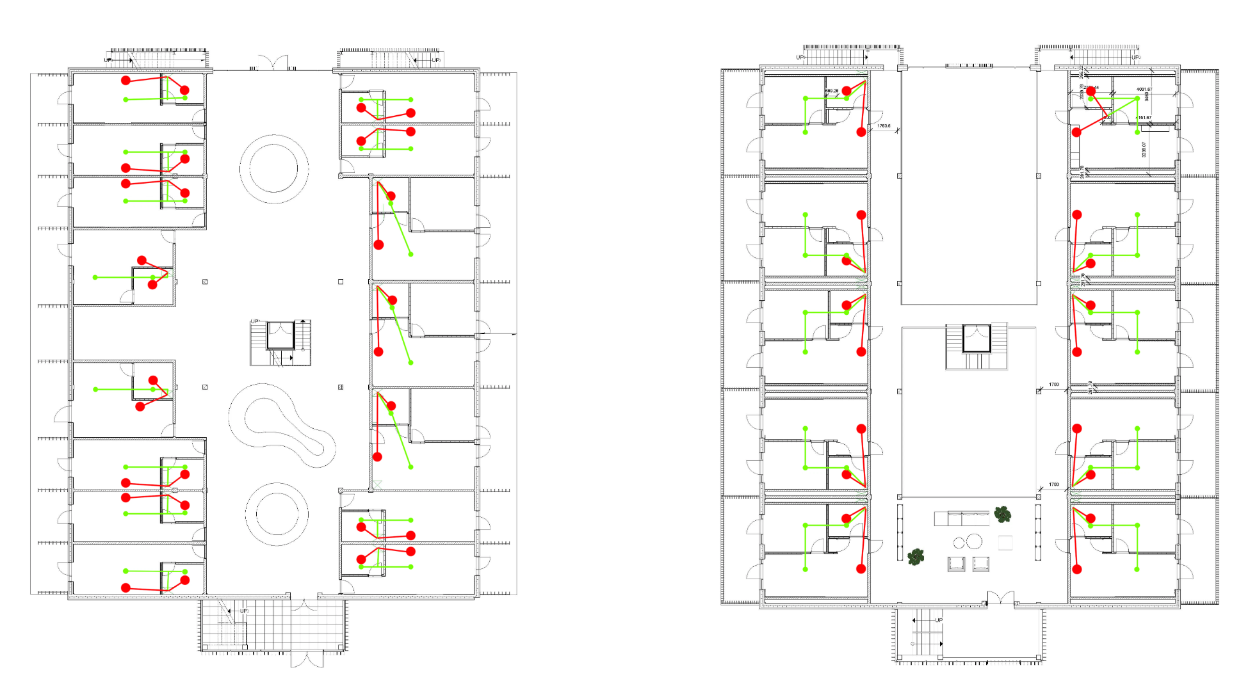
PHASE
IDEAS
PLANS
ANALYSIS & CALCULATIONS
FLOOR PLANS
GROUP
ELEVATION
REGISTRATION PHASE
OUTLINE PROPOSAL
PROJECT PROPOSAL
REGULATORY PROJECT
FIRE RESISTANT WALLS and
ESCAPE ROUTES
VENTILATION PLAN
HEATING PLAN
DOCUMENT
LIST
1
2
GROUP IEVA JULIA LEKHYA ZITA ANDREAS

Slide 16
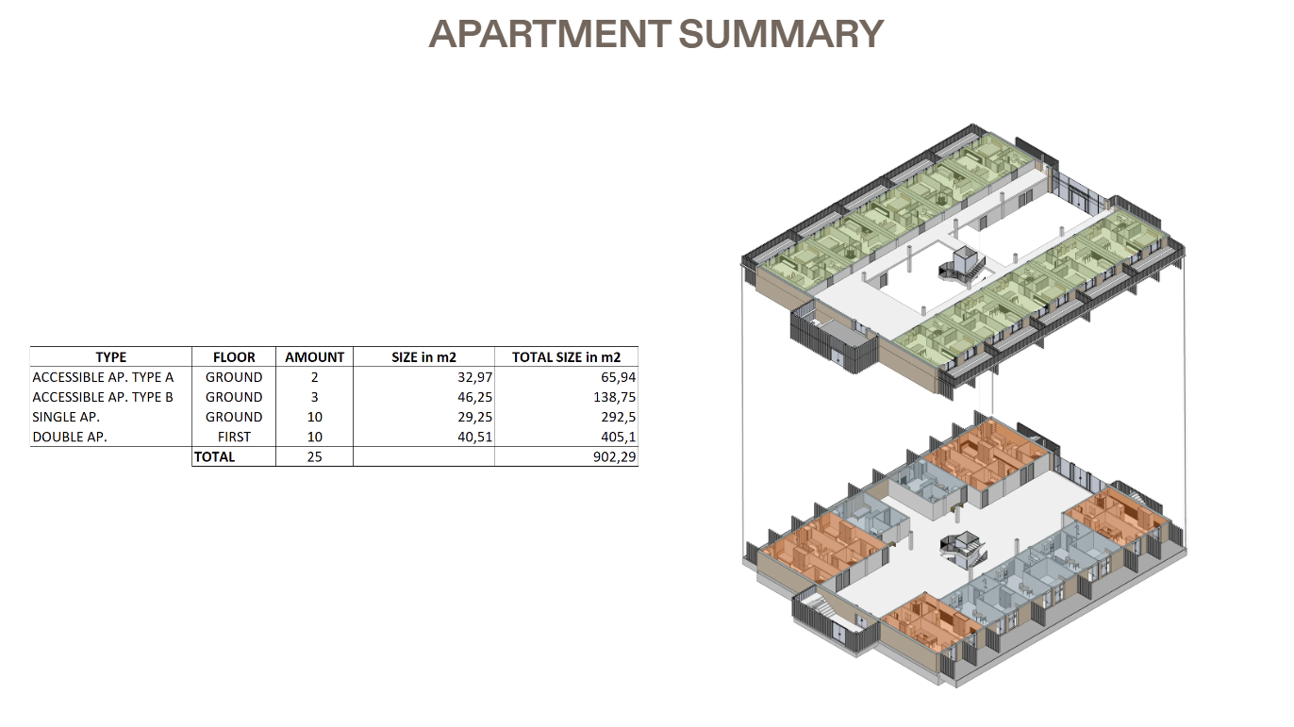
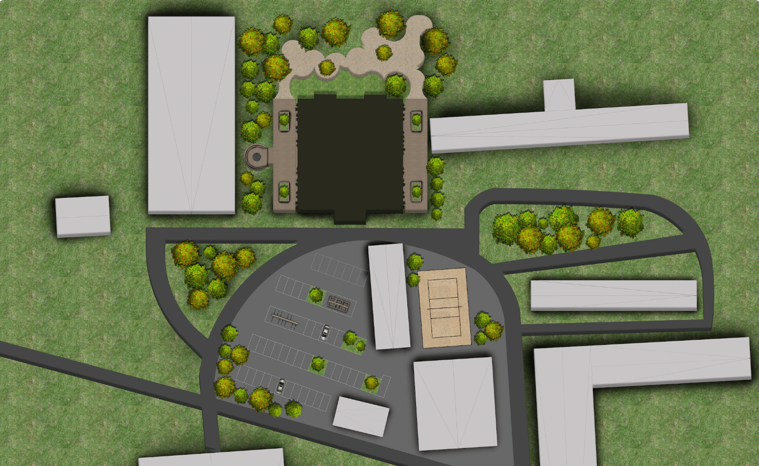
PHASE
IDEAS
PLANS
ANALYSIS & CALCULATIONS
GROUP
REGISTRATION PHASE
APARTMENT SUMMARY
SITE PLAN
OUTLINE PROPOSAL
PROJECT PROPOSAL
REGULATORY PROJECT
DOCUMENT
LIST
1
2
GROUP IEVA JULIA LEKHYA ZITA ANDREAS

Slide 17
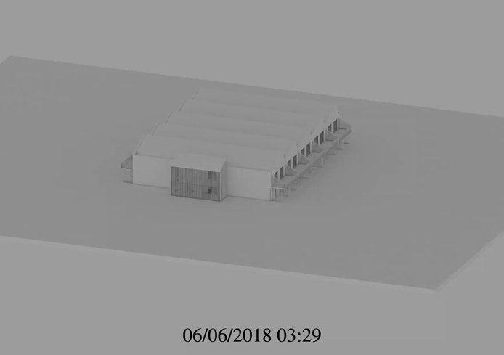
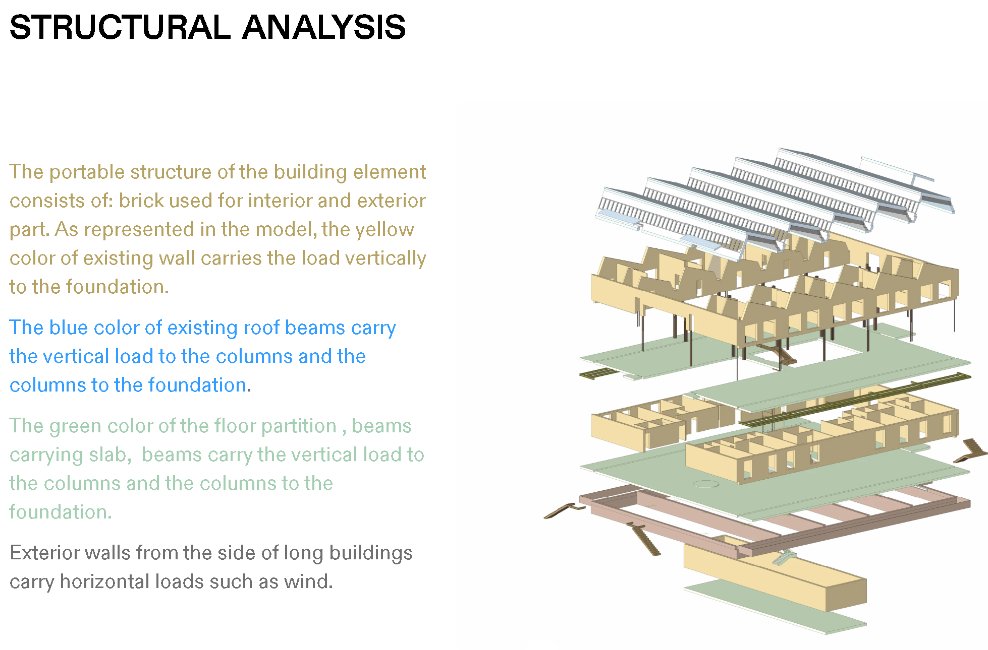
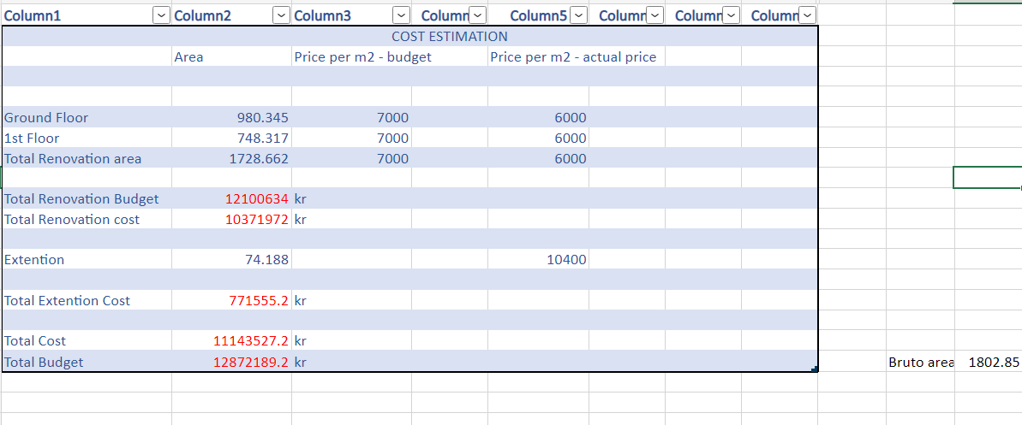
PHASE
IDEAS
PLANS
ANALYSIS & CALCULATIONS
GROUP
COST ESTIMATION
SUN ANALYSIS
STRUCTURAL ANALYSIS
REGISTRATION PHASE
OUTLINE PROPOSAL
PROJECT PROPOSAL
REGULATORY PROJECT
DOCUMENT
LIST
TIME SCHEDULE
GROUP IEVA JULIA LEKHYA ZITA ANDREAS

Slide 18
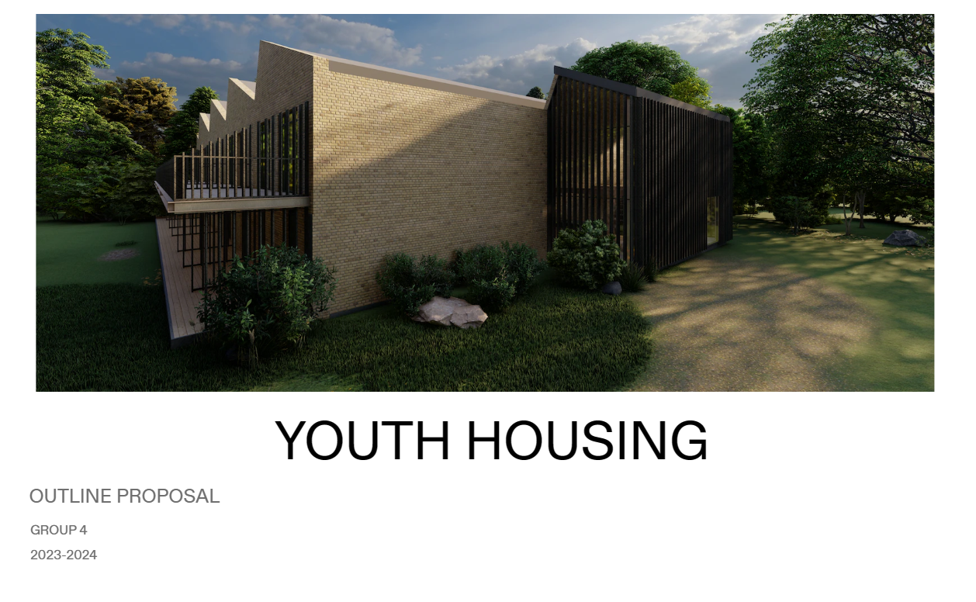
PHASE
IDEAS
PLANS
ANALYSIS & CALCULATIONS
GROUP
REGISTRATION PHASE
OUTLINE PROPOSAL
PROJECT PROPOSAL
REGULATORY PROJECT
DOCUMENT
LIST
GROUP IEVA JULIA LEKHYA ZITA ANDREAS

Slide 19
PHASE
PLANS
DETAILS
ANALYSIS & CALCULATIONS
GROUP
Project proposal is a revision and updating of outline proposal.
Project proposal focus shift from: “design proposal” to “technical proposal”
The most important task in this phase, is to identify problems and of course... solve them.
REGISTRATION PHASE
OUTLINE PROPOSAL
PROJECT PROPOSAL
REGULATORY PROJECT
DOCUMENT
LIST
GROUP IEVA JULIA LEKHYA ZITA ANDREAS

Slide 20
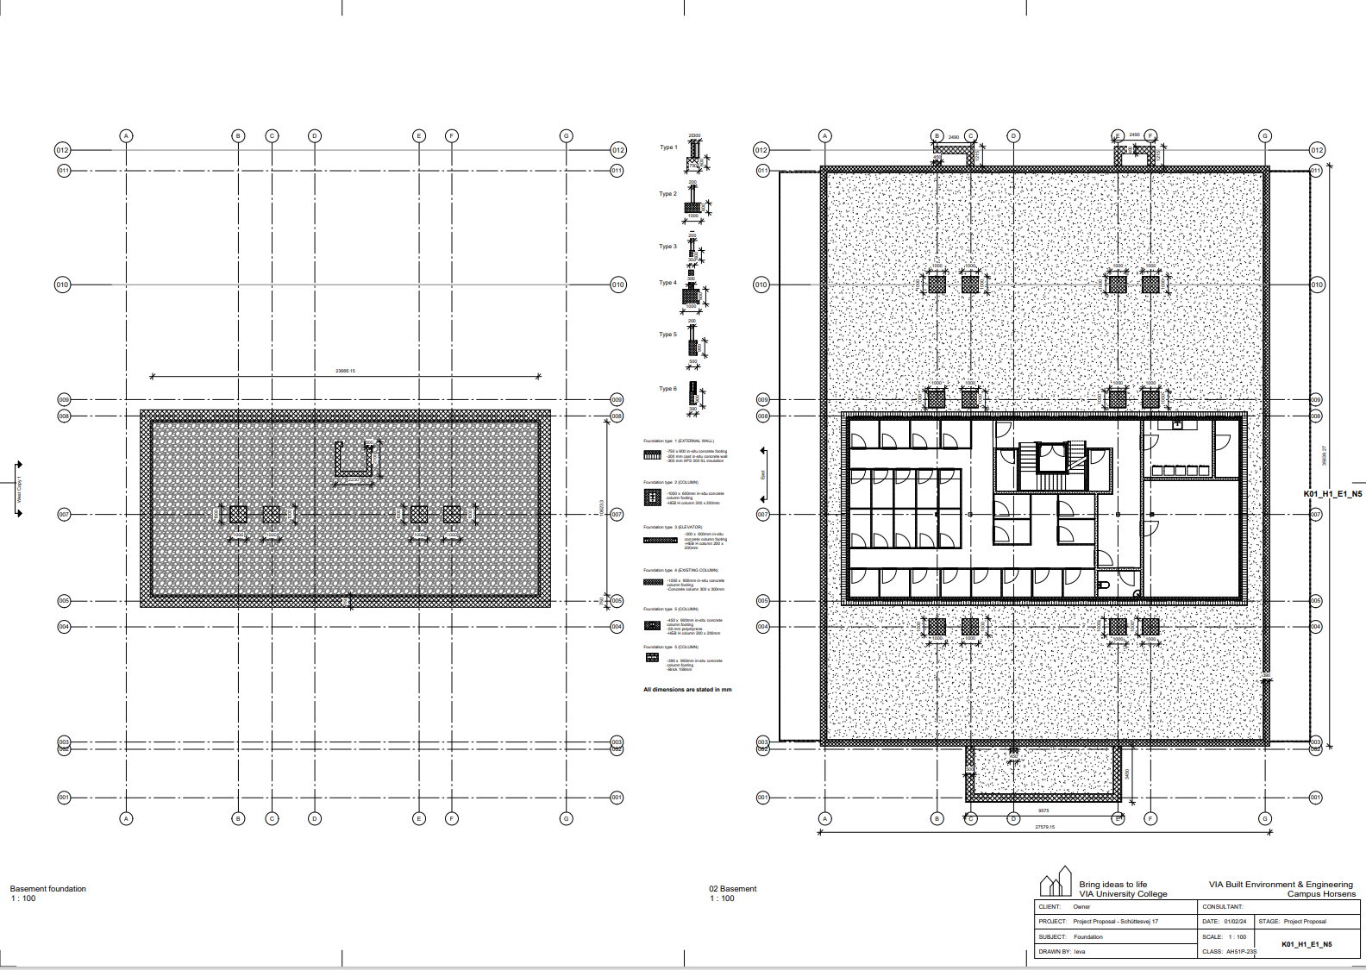
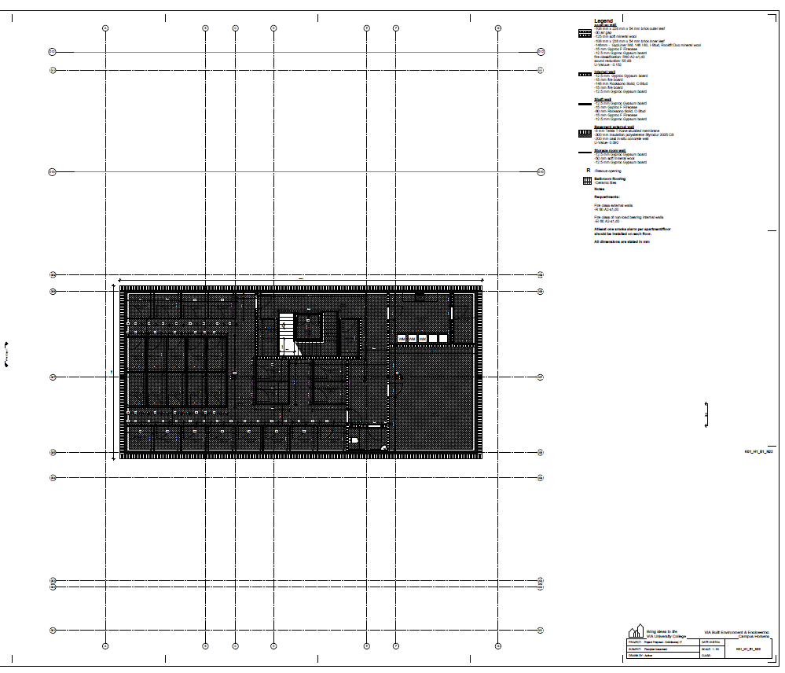
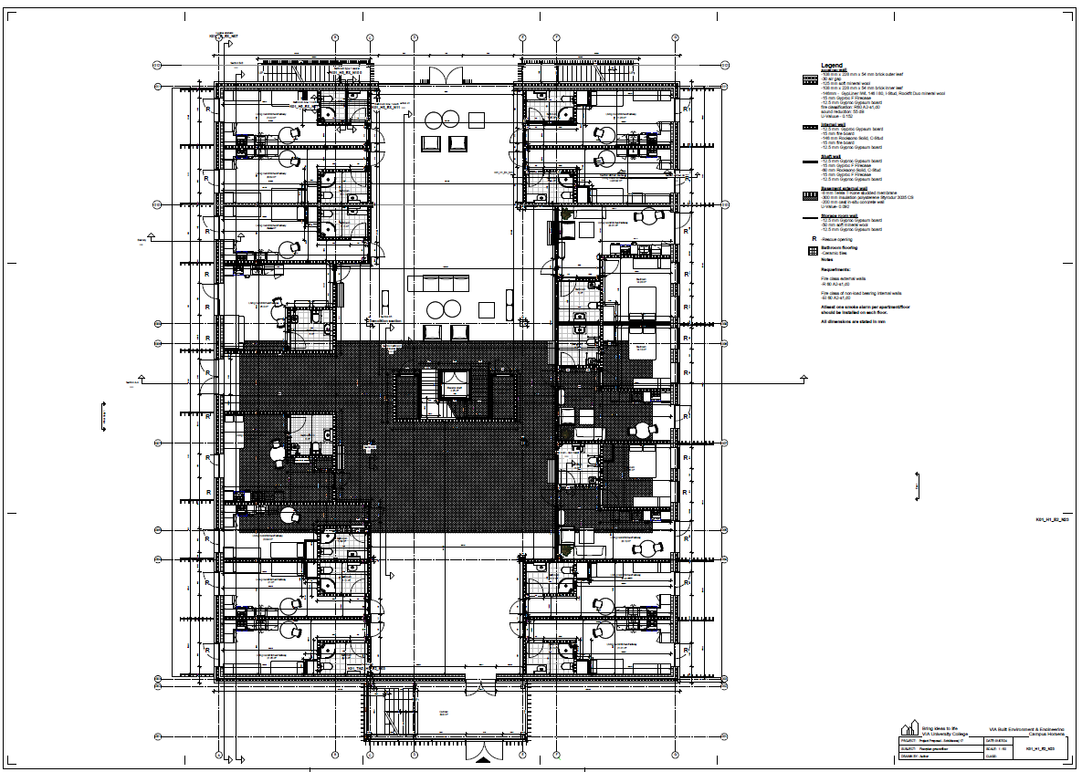
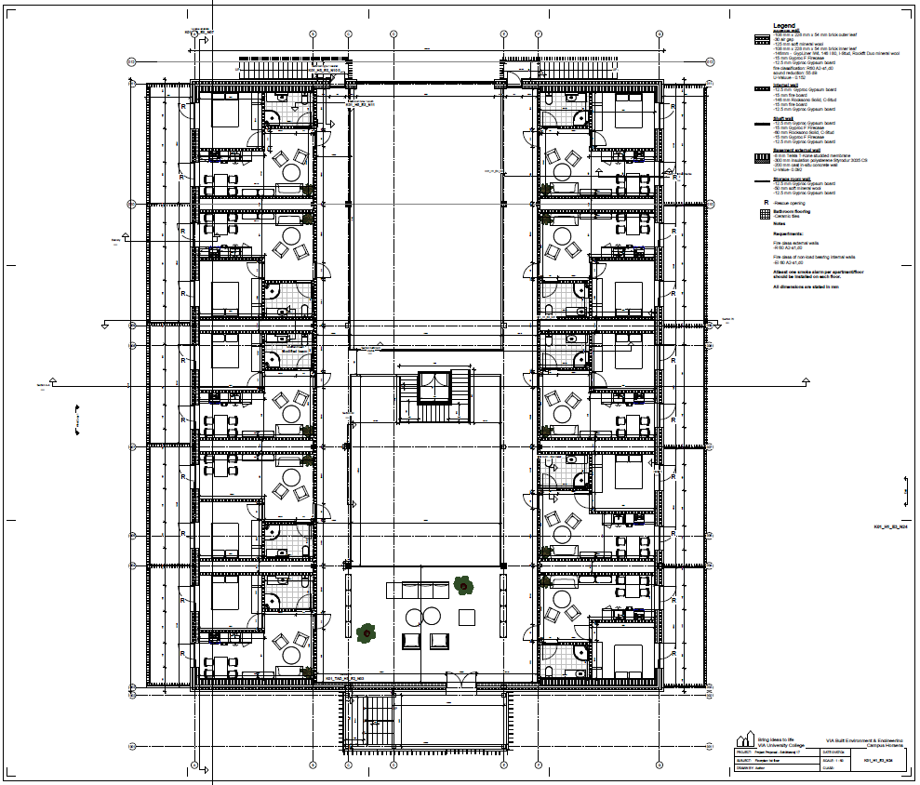
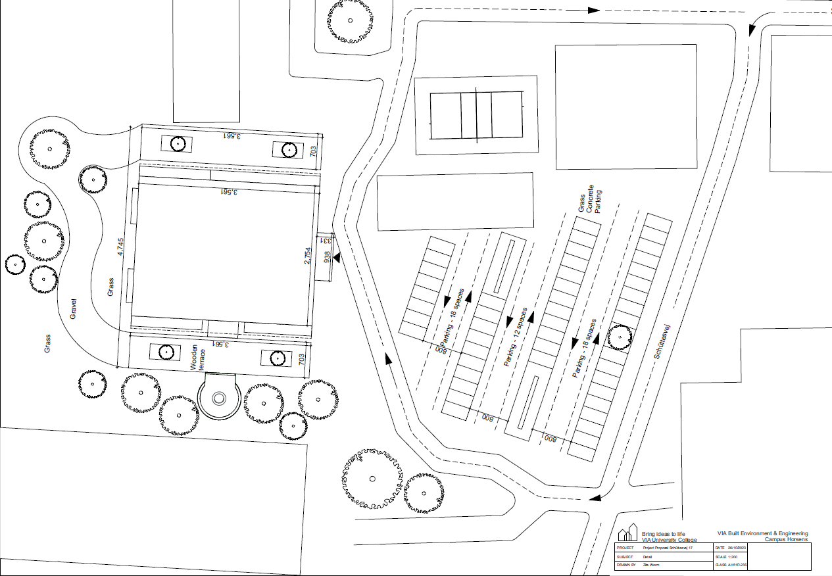
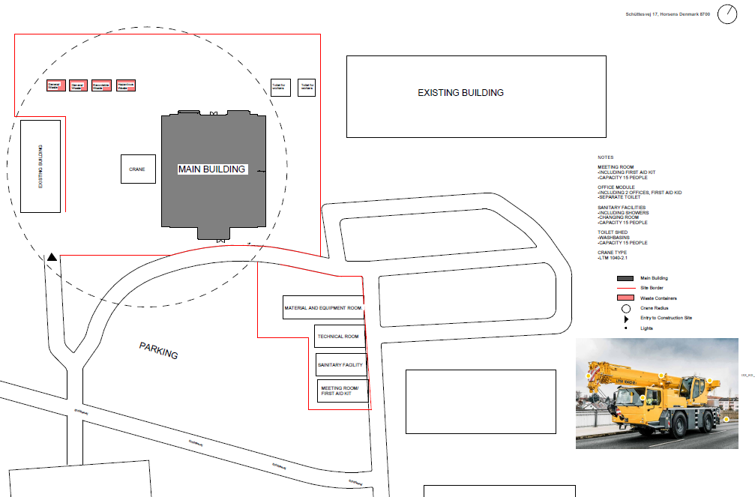
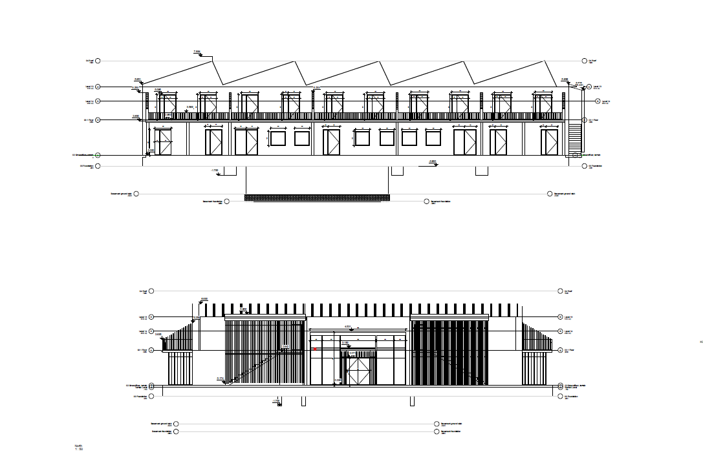
PHASE
PLANS
DETAILS
ANALYSIS & CALCULATIONS
GENERAL
SERVICES
FIRE DEPARTMENTS
GROUP
FLOOR PLANS
FOUNDATION PLAN
REGISTRATION PHASE
OUTLINE PROPOSAL
PROJECT PROPOSAL
REGULATORY PROJECT
SITE PLAN
BUILDING SITE PLAN
ELEVATIONS
DOCUMENT
LIST
1
2
GROUP IEVA JULIA LEKHYA ZITA ANDREAS

Slide 21
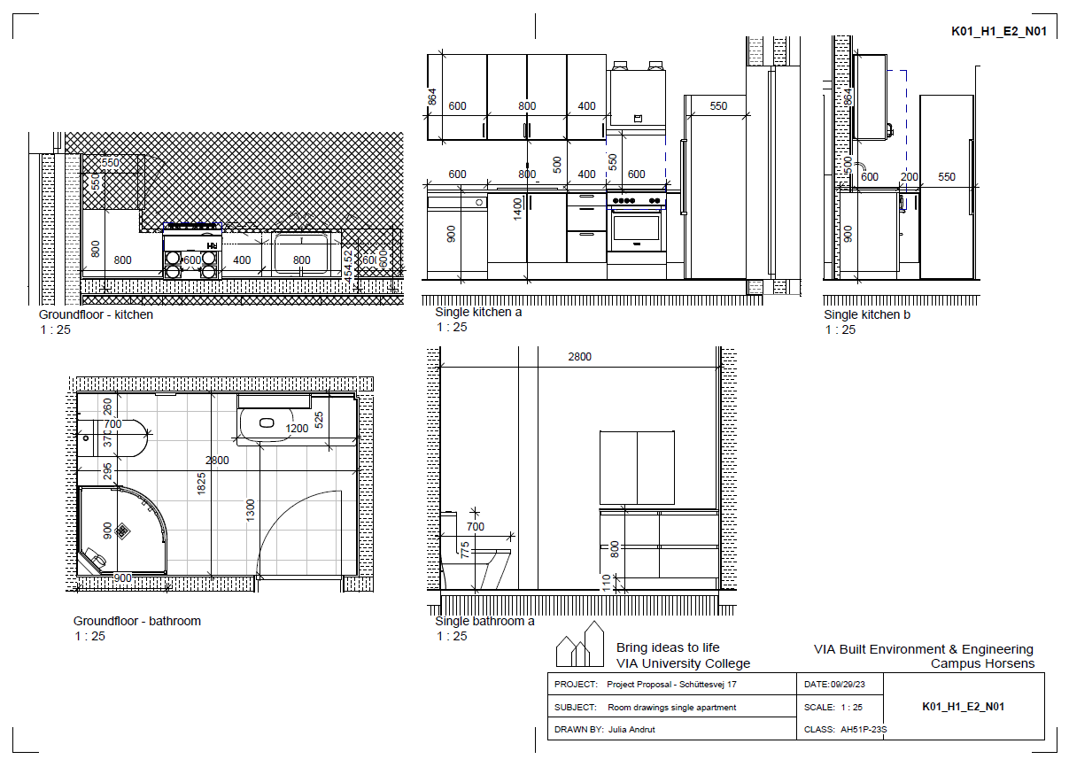
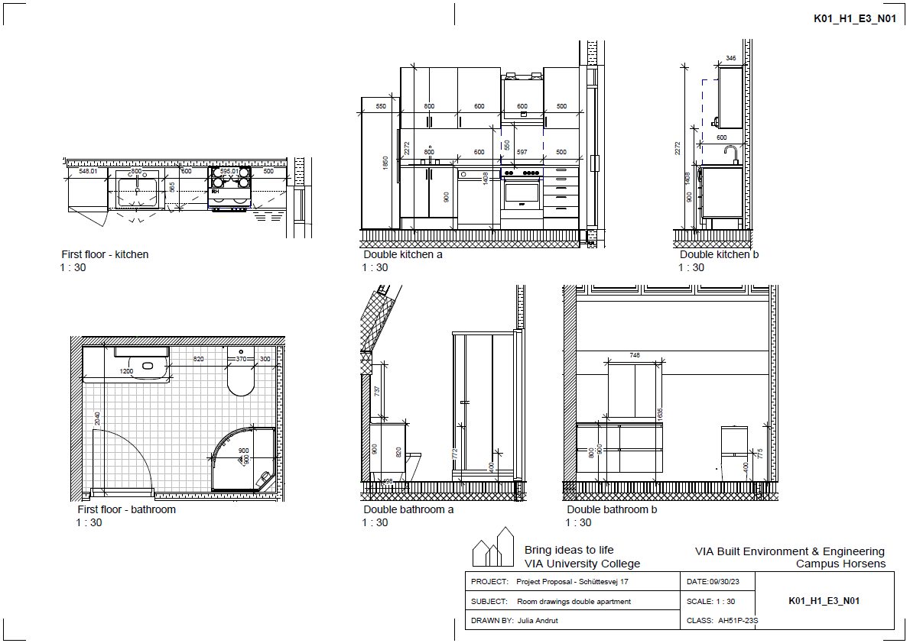
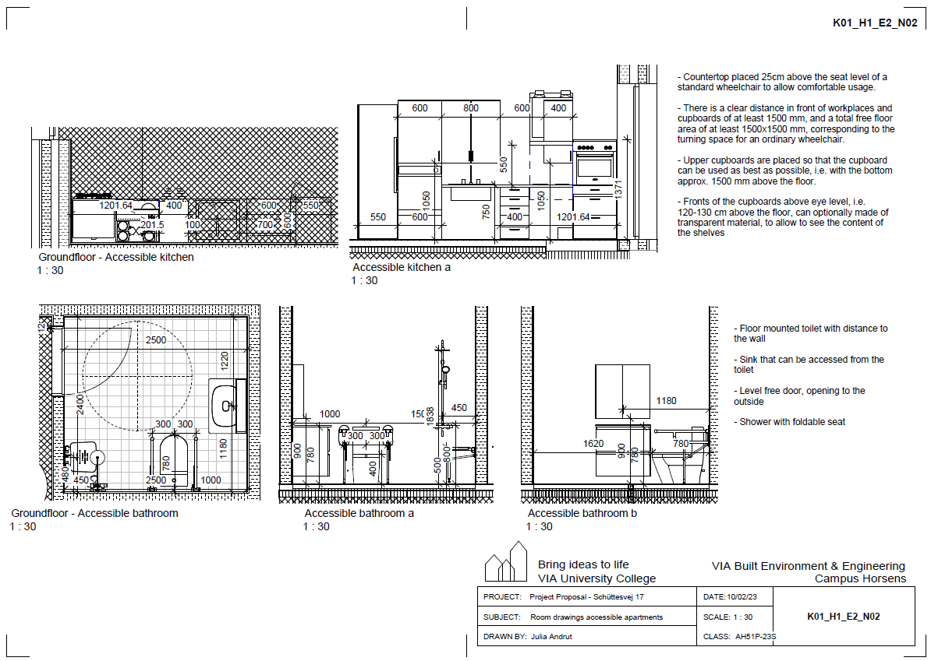
PHASE
ANALYSIS & CALCULATIONS
PHASE
PLANS
PLANS
DETAILS
DETAILS
CALCULATIONS
GENERAL
SERVICES
FIRE DEPARTMENTS
GENERAL
SERVICES
FIRE DEPARTMENTS
GROUP
ROOM DRAWINGS SINGLE
ROOM DRAWINGS DOUBLE
REGISTRATION PHASE
OUTLINE PROPOSAL
PROJECT PROPOSAL
REGULATORY PROJECT
ROOM DRAWINGS ACCESSIBLE
DOCUMENT
LIST
1
2
GROUP IEVA JULIA LEKHYA ZITA ANDREAS

Slide 22
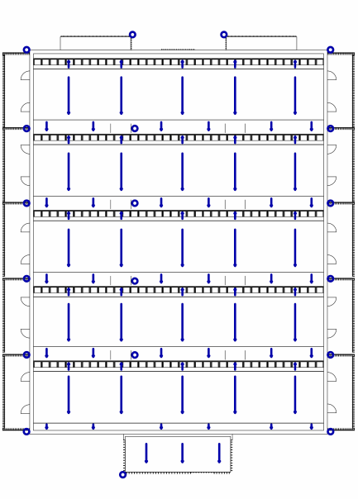
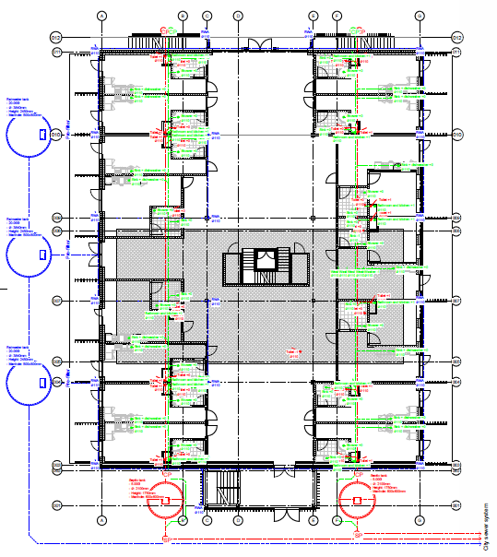
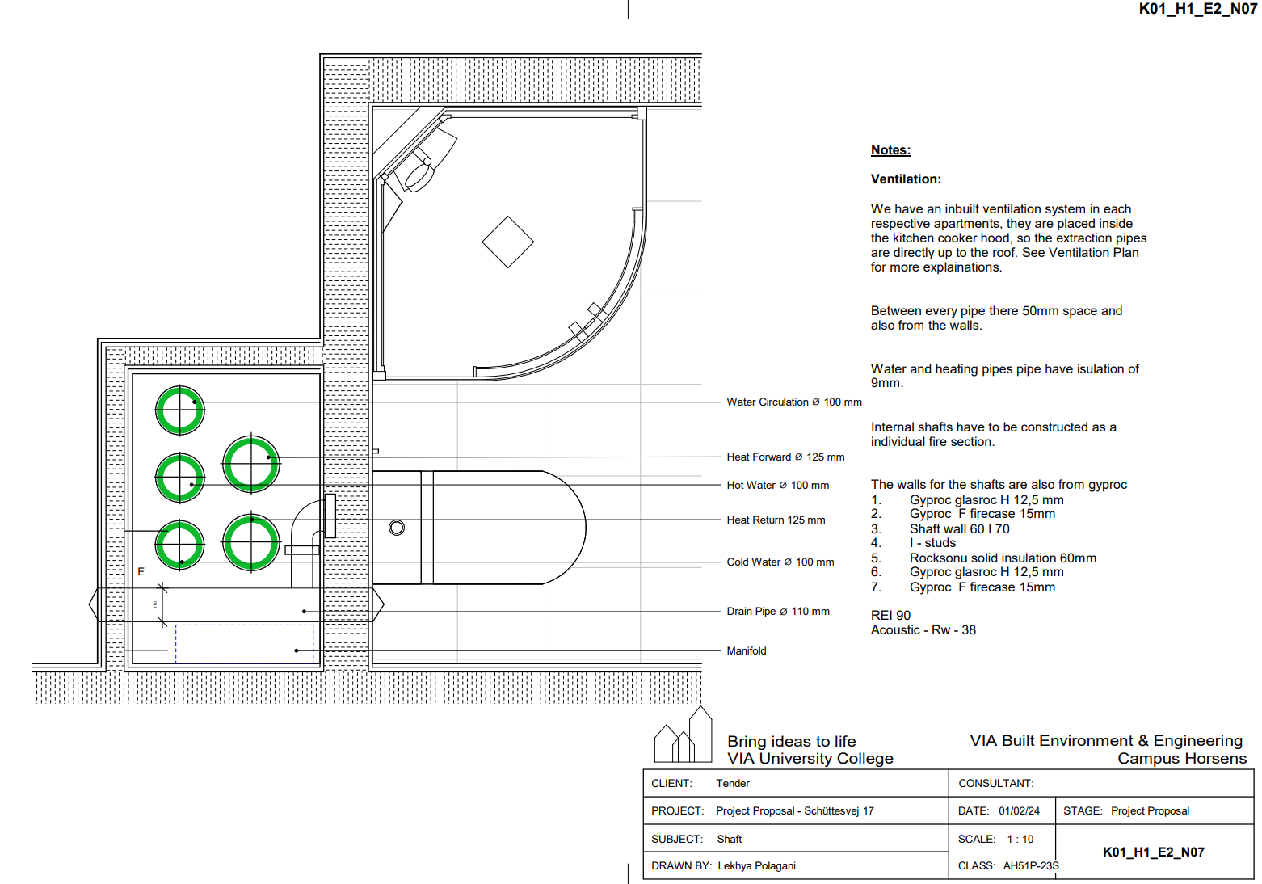
PHASE
PLANS
DETAILS
ANALYSIS & CALCULATIONS
GENERAL
GENERAL
SERVICES
SERVICES
FIRE DEPARTMENTS
FIRE DEPARTMENTS
GROUP
SEWER PLAN
GENERAL SHAFT PLAN
RAINWATER PLAN
REGISTRATION PHASE
OUTLINE PROPOSAL
PROJECT PROPOSAL
REGULATORY PROJECT
DOCUMENT
LIST
1
2
GROUP IEVA JULIA LEKHYA ZITA ANDREAS

Slide 23
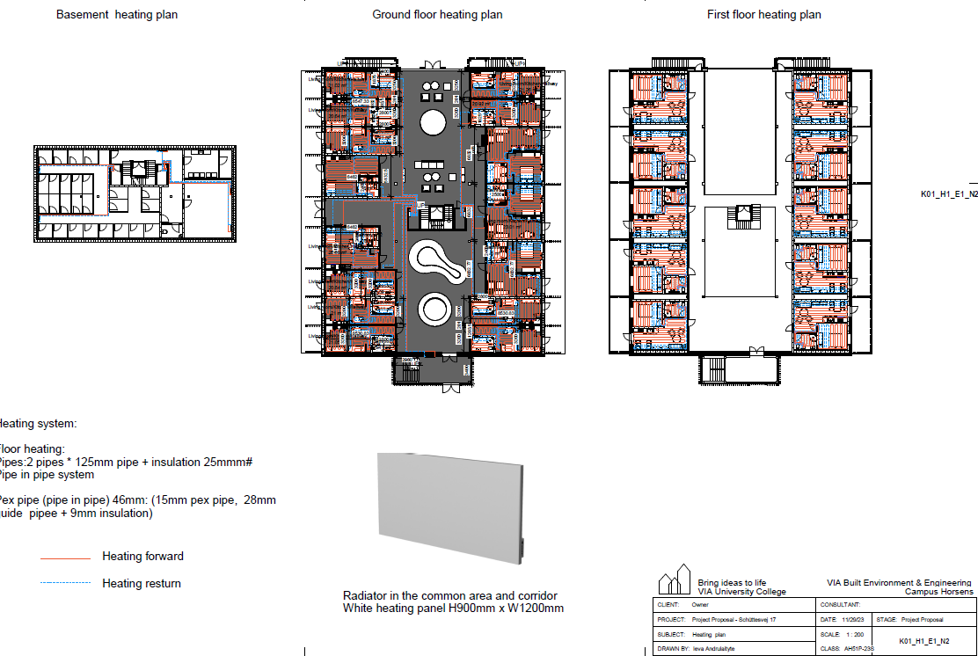
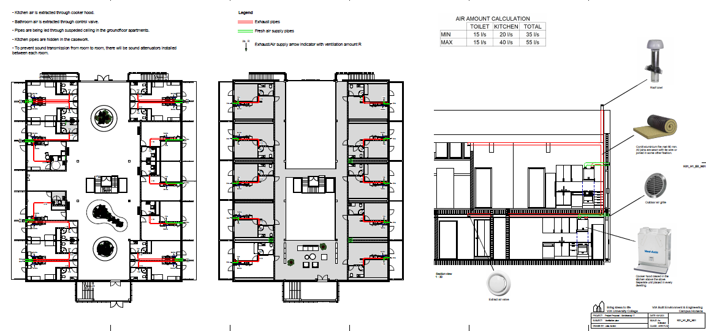
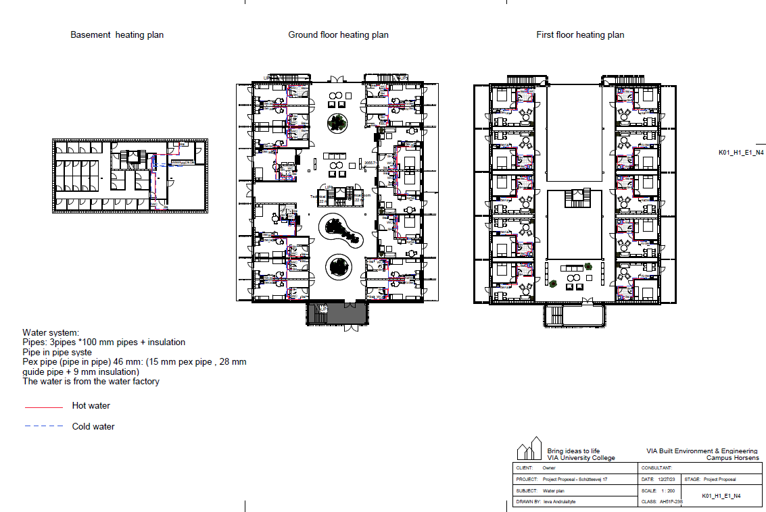
PHASE
PLANS
DETAILS
ANALYSIS & CALCULATIONS
GENERAL
GENERAL
SERVICES
SERVICES
FIRE DEPARTMENTS
FIRE DEPARTMENTS
GROUP
HEATING PLAN
REGISTRATION PHASE
VENTILATION PLAN
OUTLINE PROPOSAL
PROJECT PROPOSAL
REGULATORY PROJECT
WATER PLAN
DOCUMENT
LIST
1
2
GROUP IEVA JULIA LEKHYA ZITA ANDREAS

Slide 24




PHASE
PLANS
DETAILS
ANALYSIS & CALCULATIONS
GENERAL
GENERAL
SERVICES
SERVICES
FIRE DEPARTMENTS
FIRE DEPARTMENTS
GROUP
FIRE ANALYSIS
REGISTRATION PHASE
OUTLINE PROPOSAL
PROJECT PROPOSAL
REGULATORY PROJECT
DOCUMENT
LIST
GROUP IEVA JULIA LEKHYA ZITA ANDREAS

Slide 25




PHASE
PLANS
DETAILS
ANALYSIS & CALCULATIONS
LOAD TRANSFERRING
WIND/WATERTIGHT
GROUP
FOUNDATION
FLOOR PARTITION
WALL CONSTRUCTION
CONNECTIONS
ROOF
REGISTRATION PHASE
OUTLINE PROPOSAL
EXTERNAL WALL FOUNDATION
STEEL EXTERNAL WALL FOUNDATION
BASEMENT WALL FOUNDATION
PROJECT PROPOSAL
REGULATORY PROJECT
DOCUMENT
LIST
GROUP IEVA JULIA LEKHYA ZITA ANDREAS

Slide 26


PHASE
PLANS
DETAILS
ANALYSIS & CALCULATIONS
LOAD TRANSFERRING
WIND/WATERTIGHT
GROUP
FOUNDATION
FLOOR PARTITION
WALL CONSTRUCTION
CONNECTIONS
ROOF
REGISTRATION PHASE
COLUMN BEAM PARTITION
ELEVATOR DETAIL
OUTLINE PROPOSAL
PROJECT PROPOSAL
REGULATORY PROJECT
DOCUMENT
LIST
GROUP IEVA JULIA LEKHYA ZITA ANDREAS

Slide 27

PHASE
PLANS
DETAILS
ANALYSIS & CALCULATIONS
LOAD TRANSFERRING
WIND/WATERTIGHT
GROUP
FOUNDATION
FLOOR PARTITION
WALL CONSTRUCTION
CONNECTIONS
ROOF
REGISTRATION PHASE
NON- LOAD BEARING INTERNAL WALL CONNECTION
OUTLINE PROPOSAL
PROJECT PROPOSAL
REGULATORY PROJECT
DOCUMENT
LIST
GROUP IEVA JULIA LEKHYA ZITA ANDREAS

Slide 28




PHASE
PLANS
DETAILS
ANALYSIS & CALCULATIONS
LOAD TRANSFERRING
WIND/WATERTIGHT
GROUP
FOUNDATION
FLOOR PARTITION
WALL CONSTRUCTION
CONNECTIONS
ROOF
REGISTRATION PHASE
COLUMN FOUNDATION BASEMENT
DETAIL CONNECTION OF EXTENSION
OUTLINE PROPOSAL
PROJECT PROPOSAL
STAIRCASE IN THE EXTENSION
REGULATORY PROJECT
MODIFIED CONCRETE BEAM
DOCUMENT
LIST
GROUP IEVA JULIA LEKHYA ZITA ANDREAS

Slide 29






PHASE
PLANS
DETAILS
ANALYSIS & CALCULATIONS
LOAD TRANSFERRING
WIND/WATERTIGHT
GROUP
FOUNDATION
FLOOR PARTITION
WALL CONSTRUCTION
CONNECTIONS
ROOF
REGISTRATION PHASE
COMPLETE ROOF
GABLE ROOF CONNECTION
ROOF RIDGE
OUTLINE PROPOSAL
PROJECT PROPOSAL
REGULATORY PROJECT
ROOF EXTENSION EAVE
EAVE ROOF CONNECTION
ROOF AIR EXTRACTION
DOCUMENT
LIST
GROUP IEVA JULIA LEKHYA ZITA ANDREAS

Slide 30






PHASE
PLANS
DETAILS
ANALYSIS & CALCULATIONS
LOAD TRANSFERRING
WIND/WATERTIGHT
GROUP
OPENINGS
WET ROOM
BALCONY
TERRACE
REGISTRATION PHASE
ENTRANCE DOOR
1st FLOOR EXTERIOR FIRE DOOR DETAIL
GROUND FLOOR EXTERIOR WINDOW
OUTLINE PROPOSAL
PROJECT PROPOSAL
REGULATORY PROJECT
SKYLIGHT
BALCONY DOOR
CURTAIN WALL
DOCUMENT
LIST
GROUP IEVA JULIA LEKHYA ZITA ANDREAS

Slide 31

PHASE
PLANS
DETAILS
ANALYSIS & CALCULATIONS
LOAD TRANSFERRING
WIND/WATERTIGHT
GROUP
OPENINGS
WET ROOM
BALCONY
TERRACE
REGISTRATION PHASE
WET ROOM INTERNAL DOOR
OUTLINE PROPOSAL
PROJECT PROPOSAL
REGULATORY PROJECT
DOCUMENT
LIST
GROUP IEVA JULIA LEKHYA ZITA ANDREAS

Slide 32

PHASE
PLANS
DETAILS
ANALYSIS & CALCULATIONS
LOAD TRANSFERRING
WIND/WATERTIGHT
GROUP
OPENINGS
WET ROOM
BALCONY
TERRACE
REGISTRATION PHASE
BALCONY CONNECTION
OUTLINE PROPOSAL
PROJECT PROPOSAL
REGULATORY PROJECT
DOCUMENT
LIST
GROUP IEVA JULIA LEKHYA ZITA ANDREAS

Slide 33

PHASE
PLANS
DETAILS
ANALYSIS & CALCULATIONS
LOAD TRANSFERRING
WIND/WATERTIGHT
GROUP
OPENINGS
WET ROOM
BALCONY
TERRACE
REGISTRATION PHASE
TERRACE AND LEVEL ACCESS
OUTLINE PROPOSAL
PROJECT PROPOSAL
REGULATORY PROJECT
DOCUMENT
LIST
GROUP IEVA JULIA LEKHYA ZITA ANDREAS

Slide 34






PHASE
ANALYSIS & CALCULATIONS
PHASE
PLANS
PLANS
DETAILS
DETAILS
ANALYSIS & CALCULATIONS
GROUP
U-VALUE ANALYSIS
SOUND ANALYSIS
CONSTRUCTION TIME SCHEDULE
REGISTRATION PHASE
OUTLINE PROPOSAL
PROJECT PROPOSAL
REGULATORY PROJECT
COMPONENT LOG
COST ESTIMATION
COMPONENT COMPARISON
DOCUMENT
LIST
1
2
GROUP IEVA JULIA LEKHYA ZITA ANDREAS

Slide 35




PHASE
ANALYSIS & CALCULATIONS
PHASE
PLANS
PLANS
DETAILS
DETAILS
ANALYSIS & CALCULATIONS
GROUP
LCA CALCULATION
STRUCTURAL ANALYSIS
REGISTRATION PHASE
OUTLINE PROPOSAL
PROJECT PROPOSAL
REGULATORY PROJECT
APARTMENT TYPES
DOCUMENT
LIST
1
2
GROUP IEVA JULIA LEKHYA ZITA ANDREAS

Slide 36
PHASE
APPLICATION
DOCUMENTS
GROUP
What is a regulatory project?
Regulatory projects involves multiple partners to implement high-level requirements, responds to regulatory criteria, and deliver work within a specified timeframe.
REGISTRATION PHASE
OUTLINE PROPOSAL
PROJECT PROPOSAL
REGULATORY PROJECT
DOCUMENT
LIST
GROUP IEVA JULIA LEKHYA ZITA ANDREAS

Slide 37






PHASE
APPLICATION
DOCUMENTS
Consultant agreement
Building permit
Tender Invitation
GROUP
REGISTRATION PHASE
OUTLINE PROPOSAL
PROJECT PROPOSAL
REGULATORY PROJECT
Case specification
Legal timeline
Health and safety
DOCUMENT
LIST
GROUP IEVA JULIA LEKHYA ZITA ANDREAS

Slide 38

PHASE
APPLICATION
DOCUMENTS
PLANS
DETAILS
GROUP
REGISTRATION PHASE
FLOOR PLANS
CROSS SECTIONS
OUTLINE PROPOSAL
PROJECT PROPOSAL
REGULATORY PROJECT
SITE PLAN
FIRE PLAN
ELEVATIONS
BUILDING SITE PLAN
DOCUMENT
LIST
GROUP IEVA JULIA LEKHYA ZITA ANDREAS

Slide 39
PHASE
APPLICATION
DOCUMENTS
PLANS
DETAILS
GROUP
FOUNDATION
ROOF
REGISTRATION PHASE
BASEMENT
EXTERNAL
EAVE
GABLE
OUTLINE PROPOSAL
PROJECT PROPOSAL
REGULATORY PROJECT
CONNECTIONS
DOCUMENT
LIST
BEAM
STEEL COLUMN
GROUP IEVA JULIA LEKHYA ZITA ANDREAS

Slide 40
DOCUMENT LIST
GROUP SARAH OLIWIA AITOR IEVA
Outline Proposal
PLANS
Floor Plan Designs
Elevation
FIRE RESISTANT WALLS and
ESCAPE ROUTES
Heating plan
Ventilation plan
Apartment smmary
Site plan
Analysis and calculation:
-Structural analysis
-Sun analysis
-Cost estimation
-Time schedule
GROUP
Regulatory Project
01 Details
-External wall Foundation
-Basement foundation
-Roof eave
-Roof ridge
-Steel column connection
-Modified concrete beam
02 Plans
-Cross section
-Floor plans
-Site plan
-Fire plan
-Elevation
-Building site plan
-Building permit
REGISTRATION PHASE
OUTLINE PROPOSAL
Project Proposal
PLANS
-Floor Plans
-Elevations
-Foundation Plan
-Fire Departaments
-Site Plan
-Ventilation plan
-Heating plan
-Room drawings
-Building Site Plan
-Rain water plan
-Sewer plan
-Shaft plan
DETAILS
-External wall foundation
-Basement wall foundation
-Steel column/external wall fouundation
-Column beam partition
-Elevator
-NON- LOAD BEARING INTERNAL WALL CONNECTION
-STAIRCASE IN THE EXTENSION
-CONNECTION OF THE EXTENSION
-MODIFIELD BEAM CONCRETE
-Gable roof connection
-Eave roof
PROJECT PROPOSAL
-Roof ridge
-Roof air extraction
-Entrance door
-1st floor exterior fire door
Groundfloor exterior window
-skylight
Balcony door
-curtain wall
-Wet room internal door
-Balcony connection
Terrace and level access
Analysis and calculation
U-Value analysis
Sound analysis
Construction time schedule
Cost estimation
Component log
Structural analysis
LCA analysis
Apartment types
REGULATORY PROJECT
Tender documents:
Tender invitation
Case specification
Consultant agreement
Building permit
Legal timeline
Health and safety
DOCUMENT
LIST

Slide 41















References
GROUP
SBI Guidelines
Building Regulations
REGISTRATION PHASE
OUTLINE PROPOSAL
PROJECT PROPOSAL
Manufacter’s Information
REGULATORY PROJECT
DOCUMENT
LIST

Slide 42
Thank you
FRONT PAGE
Group 2 - AH31-22F

Slide 43
Foundation / External loadbearing wall
BACK TO DETAILS

Slide 44
Foundation / Basement external wall
BACK TO DETAILS

Slide 45

Foundation /steel column
BACK TO DETAILS

Slide 46
COLUMN BEAM PARTITION
BACK TO DETAILS

Slide 47
ELEVATOR DETAIL
BACK TO DETAILS

Slide 48
NON- LOAD BEARING INTERNAL WALL CONNECTION
BACK TO DETAILS

Slide 49
STAIRCASE IN THE EXTENSION
BACK TO DETAILS

Slide 50
DETAIL CONNECTION OF EXTENSION
BACK TO DETAILS

Slide 51
MODIFIELD CONCRETE BEAM
BACK TO DETAILS

Slide 52
GABLE ROOF CONNECTION
BACK TO DETAILS

Slide 53
EAVE ROOF CONNECTION
BACK TO DETAILS

Slide 54
ROOF RIDGE
BACK TO DETAILS

Slide 55
ROOF AIR EXTRACTION
BACK TO DETAILS

Slide 56
ENTRANCE DOOR
BACK TO DETAILS

Slide 57

1st FLOOR EXTERIOR FIRE DOOR DETAIL
BACK TO DETAILS

Slide 58

GROUND FLOOR EXTERIOR WINDOW
BACK TO DETAILS

Slide 59
SKYLIGHT
BACK TO DETAILS

Slide 60
BALCONY DOOR
BACK TO DETAILS

Slide 61
CURTAIN WALL
BACK TO DETAILS

Slide 62
WET ROOM DETAIL
BACK TO DETAILS

Slide 63
BALCONY CONNECTION
BACK TO DETAILS

Slide 64
TERRACE AND LEVEL ACCESS
BACK TO DETAILS

Slide 65

ROOF EXTENSION EAVE
BACK TO DETAILS

Slide 66
Construction Time schedule
BACK TO CALCULATIONS

